Slide 1
Delinquency and Receivables Management
BAAR Phase 3 Training

Slide 2
Welcome!
2

Slide 3
Delinquency and Receivables Management – Table of Contents
Segment 1: Delinquency and Receivables Management Overview
Segment 2: Outstanding Bills Query
Segment 3: Overdue Charges
Segment 4: Statement Level Dunning
Segment 5: Non-IPAC Write-Offs
Segment 6: Non-IPAC Disputes and Correspondence
Segment 7: IPAC Chargebacks and Customer Generated Exceptions
Segment 8: PCAS Customer Novation
Segment 9: PCAS Unfilled Customer Order Reversal
Segment 10: Treasury Referral
Segment 11: Allowance for Loss
Segment 12: Treasury Report on Receivables (TROR)
3

Slide 4
Delinquency and Receivables Management Overview
4

Slide 5
Delinquency and Receivables Management – Table of Contents
Segment 1: Delinquency and Receivables Management Overview
Segment 2: Outstanding Bills Query
Segment 3: Overdue Charges
Segment 4: Statement Level Dunning
Segment 5: Non-IPAC Write-Offs
Segment 6: Correspondence and Non-IPAC Disputes
Segment 7: IPAC Chargebacks and Customer Generated Exceptions
Segment 8: PCAS Customer Novation
Segment 9: PCAS Unfilled Customer Order Reversal
Segment 10: Treasury Referral
Segment 11: Allowance for Loss
Segment 12: Treasury Report on Receivables (TROR)
5

Slide 6
Overdue Charges
Delinquency and Receivables Management
Multiple Delinquency & Receivables Management processes are in place for bills that are not paid in full by the Collection Due Date and those where the customer has formally submitted a Dispute Request
Overdue Charges
Statement Level Dunning
Non-IPAC Write-Offs
Non-IPAC Disputes
IPAC Chargebacks
IPAC Customer Generated Exceptions
PCAS Customer Novation
PCAS Unfilled Customer Order Reversal
Treasury Referral
Allowance for Loss
Treasury Report on Receivables
Record Collection
Disputes/
Chargebacks
Process Write off/ Adjustment/ Treasury Referral
Track Receivable & Record Overdue Charges

Slide 7
Delinquency Management – Key Concepts
Overdue Charges
Overdue charges are late fees applied to outstanding Billing Documents (BD) past their Collection Due Date
GSA calculates and assesses the following 3 types of overdue charges (IP&A):
Interest Charges
Penalty Charges
Administrative Charges
7
Notes:
Overdue charges are assessed on the outstanding BD at the Accounting Line level after the BD’s Collection Due Date

Slide 8
Delinquency Management – Key Concepts
Overdue Charges
Applied for Non-Federal customers doing business with the following Business Lines
Region 6 | Region 7
R6 Claims | R7 Claims
National Assisted Acquisition Services-FEDSIM | Outlease
Regional Assisted Acquisition Services | R7 Manual Business Lines
Integrated Workplace Acquisition Center (IWAC)
Regional Network Services-Expanded Services
National IT Commodity Program
HSPD-12
Telecom/WAN
External Services
R6 Manual Business Lines
8
Notes:
Overdue charges are assessed on the outstanding BD at the Accounting Line level after the BD’s Collection Due Date

Slide 9
Delinquency Management – Key Concepts
Statement Level Dunning
Pegasys generates Dunning Notices to inform Non-Federal customers of:
Delinquent bill amounts, including principal and IP&A charges
Any collection amounts received
Sent to customers as formal notification of delinquency and requesting payment for delinquent amount cited on the notice
Ideally, non-Federal customers pay in full in advance but circumstances can happen causing the delinquency
A dunning notice is generated when the claim is established
Dunning notices are required prior to referring claims to Treasury for collection
Dunning Notices are generated at Statement level
Dunning Notices generated in Pegasys are transmitted to VCSS for the customer to view
Hard copy Dunning Notices are also mailed to customers
9

Slide 10
Receivables Management – Key Concepts
Outstanding Bills Query
Displays Unliquidated Billing Document (BD) Accounting Lines
Allows GSA to query outstanding bills using search criteria specifically designed to search and identify outstanding receivables and credit amounts
Launches BDs from query to edit or view as needed
Launches Credit Application Worksheet to apply, refund, or transfer to Treasury Non-IPAC Credits
Generates IPAC refunds
Non-IPAC Write-Offs
Manually created to Write-Off uncollectable Non-IPAC Receivables (i.e., losses)
Cash Receipt (CR) document is recorded with Line Type of “Write-Off”
Require Approval via Workflow prior to processing
10

Slide 11
Receivables Management – Key Concepts
Non-IPAC Disputes
Usually originates from customer in Vendor Customer Self-Service (VCSS) and is transmitted to Pegasys
Pegasys Disputed Billings Query
Manages dispute requests received from VCSS by customer
Provides GSA with ability to create new disputes in Pegasys on customer’s behalf
Correspondence
Records and tracks communication between GSA and the customer via transmission from/to Pegasys and VCSS
Supports internal communication within GSA
Three types of Correspondence: Statement Correspondence, Account Correspondence, and Document Correspondence
Supports attachment and email capabilities
Customer Correspondence entry automatically generates upon submission of customer dispute request received from VCSS
11

Slide 12
Receivables Management – Key Concepts
IPAC Chargebacks and Customer Generated Exceptions
When customer agency disagrees with a GSA IPAC transaction and believes the transaction is erroneous/incorrect, they “charge back” the transaction to GSA via IPAC
Treasury refers to Chargebacks as “Adjustments”
Two Types of Chargebacks: (1) Collection Adjustments & (2) Payment Adjustments
Treasury does not recognize Customer Generated Exceptions as adjustments but rather as new transactions
Two types of Customer Generated Exceptions: (1) Pull Payment & (2) Push Payment
PCAS Customer Novation
Provides ability to update (novate) the customer/vendor code on the agreement
Tracks history of all novations on an agreement
PCAS Agreement Customer Novation Batch Process automatically updates outstanding BDs referencing novated agreement

Slide 13
Receivables Management – Key Concepts
PCAS Unfilled Customer Order (UFCO) Reversal
Once a PCAS agreement has passed its End Date, PCAS AC UFCO Reversal batch job performs automated updates to agreement:
Draws down any remaining unfilled customer order balance
Returns any unused Advance amounts as customer refunds
Treasury Referral
If after 90 days the debt remains outstanding, then GSA may initiate the Treasury Referral process for collection
When referred for “Treasury Cross-Servicing”, Treasury will make attempts at collection by contacting debtors and requesting they remit payment
Region 6/7 Claims and Outlease business lines will use Pegasys referral functionality
13

Slide 14
Receivables Management – Key Concepts
Allowance for Loss
Allowance for Loss batch job: Calculates the estimated loss associated with uncollectible balances
Based on multiple selection criteria defined by each GSA business line
Posts at the detail accounting dimension level
Generates a self-reversing Standard Voucher (SV) document that posts the allowance for loss entry
Treasury Report on Receivables (TROR)
A quarterly report mandated by Treasury
Provides information regarding:
Gross book value of the receivables owed to GSA
Status of the Federal Government’s debt portfolio
Note: Delinquency and Receivable Management as it relates to IPAC and Debt Account will be covered at a high level in this training course. Detailed coverage will be included in the following training courses:
IPAC Lifecycle
Debt Account Lifecycle

Slide 15
Outstanding Bills Query
15

Slide 16
Delinquency and Receivables Management – Table of Contents
Segment 1: Delinquency and Receivables Management Overview
Segment 2: Outstanding Bills Query
Information Displayed
Search Capabilities
Additional Functionality for Users
Segment 3: Overdue Charges
Segment 4: Statement Level Dunning
Segment 5: Non-IPAC Write-Offs
Segment 6: Correspondence and Non-IPAC Disputes
Segment 7: IPAC Chargebacks and Customer Generated Exceptions
Segment 8: PCAS Customer Novation
Segment 9: PCAS Unfilled Customer Order Reversal
Segment 10: Treasury Referral
Segment 11: Allowance for Loss
Segment 12: Treasury Report on Receivables (TROR)
16

Slide 17
Outstanding Bills Query – Displayed Information
Displayed Information
The Outstanding Bills Query displays all unliquidated BD Accounting Lines
The query is updated as BDs are 1) processed and 2) drawn down via Cash Receipts
Billing information remains in the query until the outstanding amount becomes zero
Search Capabilities
The Outstanding Bills Query allows GSA to query outstanding bills (e.g., uncollected, not written-off) using numerous search criteria
Provides ability to search for outstanding:
Normal BD balances
Credit BD balances (which can then be applied, refunded, transferred to Treasury)
Additional Functionality
The Outstanding Bills Query also allows users to:
Launch BDs from the query to edit or view
Launch the Credit Application Worksheet to apply, refund, or transfer Treasury Non-IPAC credits to Treasury
Generate IPAC refunds from the Outstanding BD Line
17

Slide 18
Outstanding Bills Query – Process
To access the Outstanding Bills Query:
Pegasys > Queries > Accounts Receivable > Outstanding Bills
Enter query criteria in the Search Criteria and Additional Criteria sections (be as detailed as possible in order to maintain system integrity), click “Search”
Select item and select “Details”
18

Slide 19
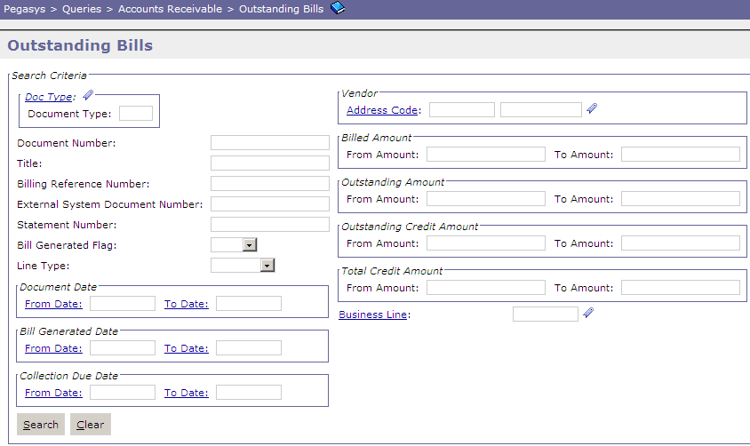
Outstanding Bills Query – Search Criteria
19

Slide 20
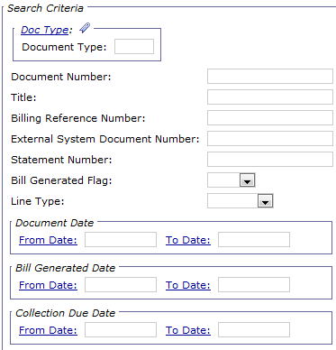
Outstanding Bills Query – Search Criteria
Statement Number - Provides the ability to search by the BD’s billing statement number
Bill Generated Flag - Setting to “True” provides ability to search for BDs for which the PDF statement has been generated
Line Type - Provides the ability to search by the type of transaction recorded on the BD’s accounting line
Normal Line Type records normal bill for customers
Credit Line Type records credits owed to customers
Bill Generated Date (From/To) – Provides the ability to search by the date the bill was generated for the customer
Collection Due Date (From/To) – Provides the ability to search by the date the bill should be paid by the customer
20

Slide 21
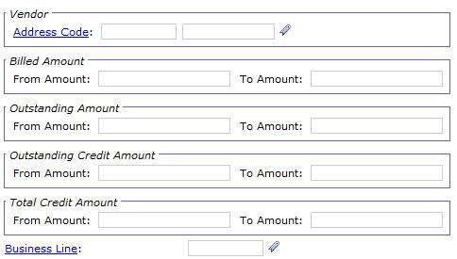
Outstanding Bills Query – Search Criteria
Vendor Code/Address Code - Provides the ability to search by the Vendor/Address Code (i.e. customer) recorded on the BD
Billing Amount (From/To) - Provides the ability to search by the amount the customer was billed
Outstanding Amount (From/To) - Provides the ability to search by the amount still outstanding on the BD
Outstanding Credit Amount (From/To) - Provides the ability to search by the credit amount still outstanding on the BD and owed to the customer
21

Slide 22
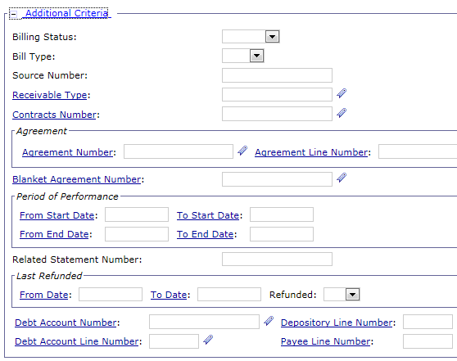
Outstanding Bills Query – Additional Criteria
Billing Status – Provides the ability to search for BDs via the Billing Statuses of Unbilled or Billed
Bill Type - Provides ability to search by the format of the Pegasys-generated billing
Blank (i.e. non-IPAC) or IPAC
Receivable Type - Provides the ability to search by the BD’s Receivable Type
Agreement Number - Provides the ability to search by the BD’s related Agreement number/line number
Last Refunded Date (From/To) -Provides the ability to search by the date an outstanding customer credit was last refunded
Refunded - Setting to “True” provides the ability to search for credit BDs that have been paid out to the customer as refunds
22

Slide 23
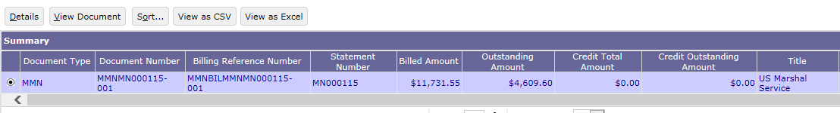
Outstanding Bills Query - Information Displayed
Results of search is displayed
Select item from item collection list and select Details
23

Slide 24
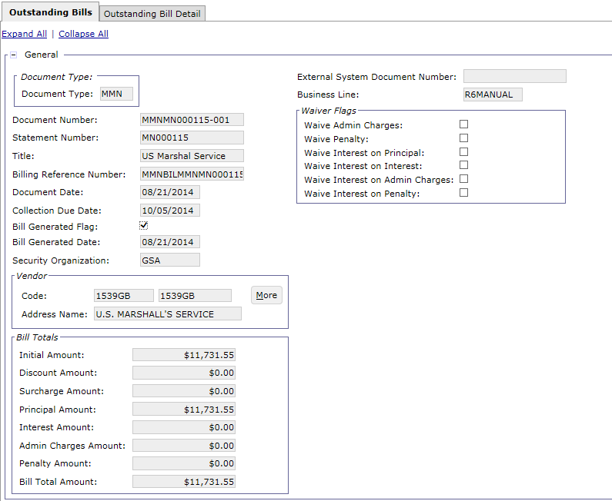
Outstanding Bills Tab – Information Displayed
24

Slide 25
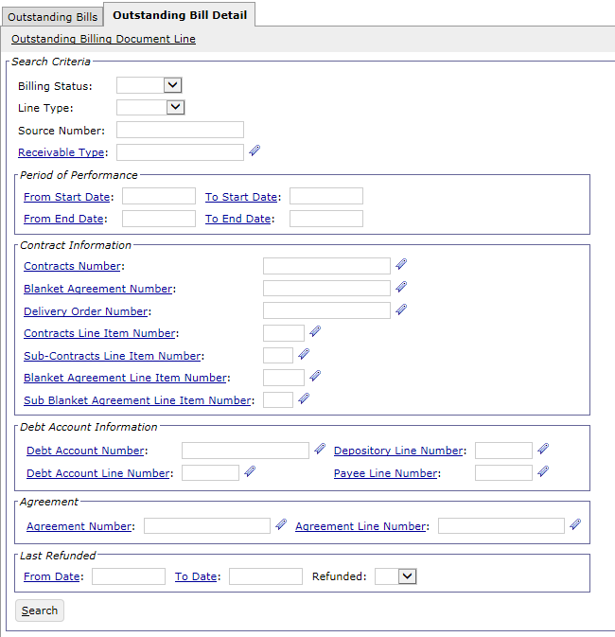
Outstanding Bill Detail Tab – Information Displayed
May enter Search criteria to narrow down the results in the Item Collection
From the narrowed search, select a BD Accounting Line and then select the Outstanding Billing Document Line hyperlink to view the outstanding detail information for selected Accounting Line
25

Slide 26
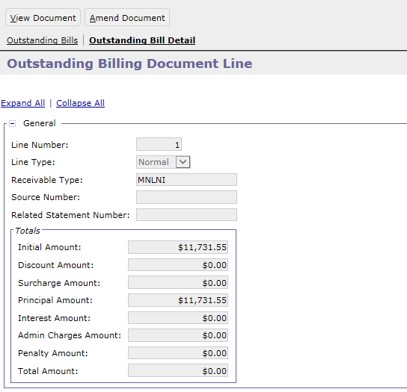
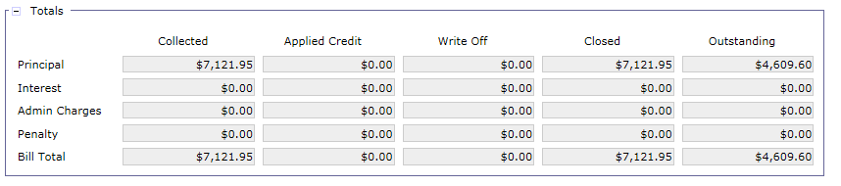
Outstanding Billing Document Line – Information Displayed
26

Slide 27
Exercise
Exercise 1 – Query and View an Outstanding Bill

Slide 28
Overdue Charges
28

Slide 29
Delinquency and Receivables Management – Table of Contents
Segment 1: Delinquency and Receivables Management Overview
Segment 2: Outstanding Bills Query
Segment 3: Overdue Charges
Segment 4: Statement Level Dunning
Segment 5: Non-IPAC Write-Offs
Segment 6: Correspondence and Non-IPAC Disputes
Segment 7: IPAC Chargebacks and Customer Generated Exceptions
Segment 8: PCAS Customer Novation
Segment 9: PCAS Unfilled Customer Order Reversal.
Segment 10: Treasury Referral
Segment 11: Allowance for Loss
Segment 12: Treasury Report on Receivables (TROR)
29

Slide 30
Overdue Charges – Introduction
Overdue charges are late fees applied to outstanding Billing Documents (BD) that are past their Collection Due Dates
GSA calculates and assesses the following 3 types of overdue charges:
Interest Charges
Penalty Charges
Administrative Charges
Overdue charges are only assessed via automated Pegasys batch processing (AROVERDUE) for Non-Federal customers
Non-Federal Receivables are due 30 days after the Bill Print date
Special exception for Outlease: Outlease BDs are due the same day the bill is created, therefore, the Collection Due Date will be the same as the Bill Print Date
GSA may manually assess overdue charges for certain Federal customers with recurring delinquency issues
Claims are due 30 days from First Demand Letter
Claims do not use billing documents to calculate overdue charges
Overdue charges are assessed on the outstanding balance of the debt account
30
Notes:
When GSA receives dispute correspondence regarding an overdue bill, the overdue charges (interest, penalty, and administrative fees) are frozen until the dispute is resolved.

Slide 31
Overdue Charges – Introduction
Business Lines assessing overdue charges
Region 6 | Region 7
R6 Claims | R7 Claims
National Assisted Acquisition Services-FEDSIM | Outlease
Regional Assisted Acquisition Services | R7 Manual Business Lines
Integrated Workplace Acquisition Center (IWAC)
Regional Network Services-Expanded Services
National IT Commodity Program
HSPD-12
Telecom/WAN
External Services
R6 Manual Business Lines
Note: The following slides cover overdue charges related to billing documents. More detailed information on overdue charges related to Debt Accounts can be found in the Debt Account Lifecycle course.
31
Notes:
Overdue charges are assessed on the outstanding BD at the Accounting Line level after the BD’s Collection Due Date

Slide 32
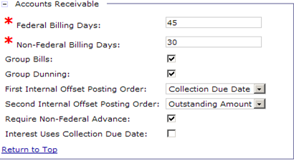
Overdue Charges – Maintenance Tables
Pegasys General System Options Maintenance table:
Specifies billing periods for Non-Federal bills that dictate assessment of Interest, Penalty, and Administrative (IP&A) charges
Non-Federal bills have a cycle of (are due in) 30 days
Interest Uses Collection Due Date flag determines the date used to calculate interest from
When set to False, calculation uses the Bill Print Date to start calculating interest charges
32

Slide 33
Overdue Charges – Maintenance Tables
Overdue Charge (IP&A) types are setup on the following maintenance tables and are configured by the funds each type hits:
Pegasys > Reference > Accounts Receivable >
Interest Type Maintenance Table
Penalty Type Maintenance Table
Administrative Charge Type Maintenance Table
33

Slide 34
Overdue Charges – IP&A Codes
Business Line | Interest Type Code | Penalty Type Code | Administrative Charge Type Code
R6 Claims | INTR6CLM | PENR6CLM | ADMINR6CLM
R6 Manual | INT285F | PEN285F | ADMIN285F
National Assisted Acquisition Services-FEDSIM | INT285F | PEN285F | ADMIN285F
Regional Assisted Acquisition Services | INT285F | PEN285F | ADMIN285F
Integrated Workplace Acquisition Center | INT285F | PEN285F | ADMIN285F
Regional Network Services-Expanded Services | INT285F | PEN285F | ADMIN285F
National IT Commodity Program | INT285F | PEN285F | ADMIN285F
HSPD-12 | INT285F | PEN285F | ADMIN285F
External Services | INT285F | PEN285F | ADMIN285F
Telecom/WAN | INT285F | PEN285F | ADMIN285F
R7 Claims | INTR7CLM | PENR7CLM | ADMINR7CLM
R7 Manual | INT192X | PEN192X | ADMIN192X
Outlease | INT192X | PEN192X | ADMIN192X
34

Slide 35
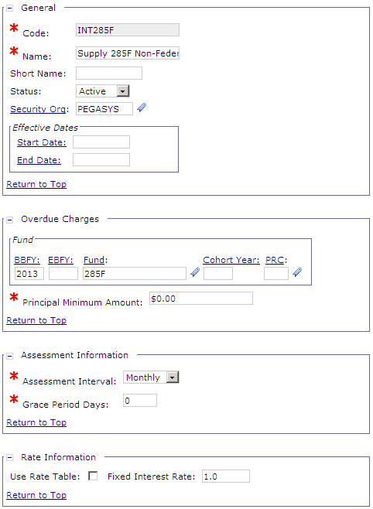
Interest Type Maintenance Table
Overdue Charges Fund - Used to determine the accounting template and transaction types from the Overdue Distributions Maintenance table used to post interest charges
Not used to post interest charges
Assessment Interval - The frequency at which interest is assessed on the BD accounting lines by AROVERDUE
Grace Period Days - The lag between the Bill Due Date/Bill Print Date on a BD and the day on which interest begins to accrue
Fixed Interest Rate - The interest rate used by AROVERDUE to assess interest
35
Notes:
The Overdue Charges Fund is not the Fund used to post interest charges. Instead, it is used to determine the accounting template and transaction types from the Overdue Distributions Maintenance table used to post the interest charges. Interest charges are posted to Fund 0230.

Slide 36
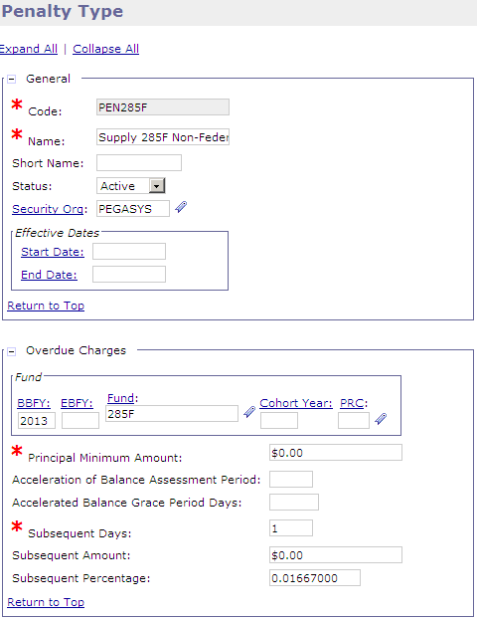
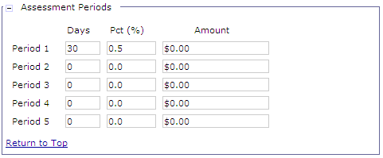
Penalty Type Maintenance Table
Period 1 Days - The number of days after Collection Due date that the first Penalty is assessed
Period 1 Pct%/Amount - Penalty percentage/amount that is assessed on the day that Period 1 Days begins calculations
Subsequent Days – The number of days after the billing document's last administrative charges apply date that subsequent charges are applied to the receivable
Subsequent Percentage – Percentage
assessed on Subsequent Days
36
Notes:
The Overdue Charges Fund is not the Fund used to post penalty charges. Instead, it is used to determine the accounting template and transaction types from the Overdue Distributions Maintenance table used to post the penalty charges. Penalty charges are posted to Fund 0190.

Slide 37
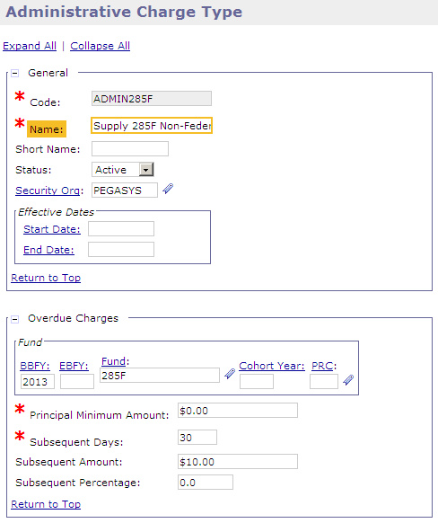

Administrative Charge Type Maintenance Table
Subsequent Days – The number of days after Collection Due Date that Administrative Charges are applied
Subsequent Amount – Dollar Amount applied once Subsequent Days have been reached
Assessment Period section will not be used for Administrative Charges
37
Notes:
The Overdue Charges Fund is not the Fund used to post administrative charges. Instead, it is used to determine the accounting template and transaction types from the Overdue Distributions Maintenance table used to post the administrative charges. Administrative charges are posted to Fund 0890.

Slide 38
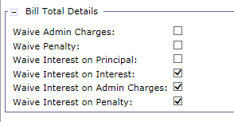
Overdue Charges – BD Header
Overdue Charges are calculated when Waive Flags are not selected in the Bill Total Details section
Waive Admin Charges = False
Waive Penalty = False
Waive Interest on Principal = False
GSA can manually waive the assessment of IP&A charges on a BD
38

Slide 39
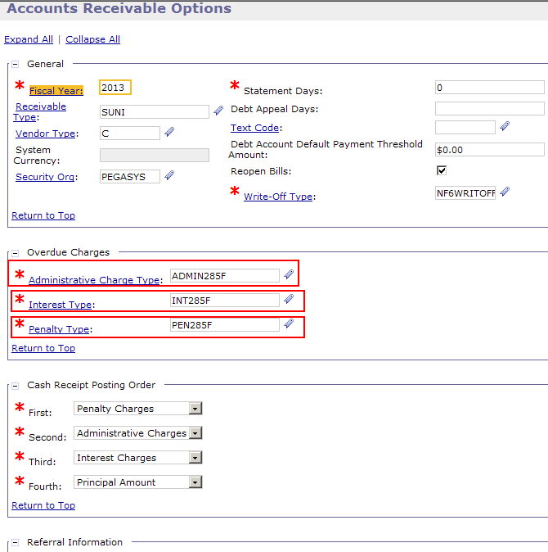
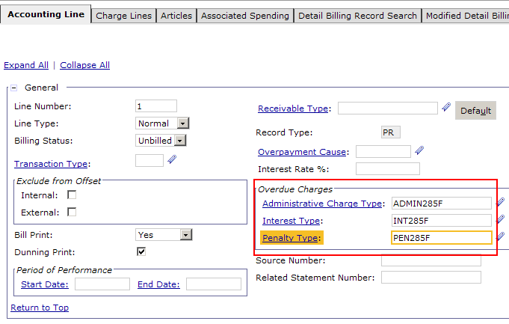
Overdue Charges – BD Accounting Line
Overdue Charge Types default on a BD’s Accounting Line based on values configured on the Accounts Receivable Options Maintenance table
39

Slide 40
Overdue Charges – Interest for R6
Interest is assessed on a monthly interval only on the Billing Document’s outstanding principal amount
Additional interest is NOT calculated on the prior month’s interest
Pegasys begins calculations on interest charges monthly from the Bill Print Date
If Collection is not received by the Due Date of the bill, interest will be assessed
Interest is assessed monthly thereafter
The interest rate applied is the fixed Treasury Current Value rate, APR
September 1
$10000 Bill is Sent
Interest Calculation Days Start
October 1
$10000 Collection is due,
Not yet paid
Interest Rate = 1% APR
10k * 0.01 * (30/360)= $8.33
Total Due: $10008.33
October 31
$10008.33 Collection is due,
Still not paid
Interest Rate = 1% APR
10k * 0.01 * (30/360)= $8.33
Total Due: $10016.66
Total Due: $10000
Status:
Interest
Rate:
Total
Due:
Notes:
Pegasys will accrue interest charges from the Bill Print Date and will then assess and post the appropriate interest charge amount through the AROVERDUE Effective Date (based on any Receivable balance that has not been fully liquidated/paid) upon the Receivable becoming overdue. This functionality is made possible by the following Pegasys maintenance table configuration in conjunction with the AROVERDUE Batch process:
General System Options Table:
· Interest Uses Collection Due Date: FALSE (because we want it to use the Bill Print Date) · Non-Federal Billing Days: 30
Interest Types Table:
· Assessment Interval: Monthly · Grace period Days: 0
The Treasury Current Value Rate as initially assessed is fixed throughout the life of the overdue receivable (even though the Treasury Current Value Rate may be updated during that period).

Slide 41
Overdue Charges – Interest for Outlease
RWA
5/1 Interest Assessed
(4/1 - 4/30)
6/1 Interest Assessed
(5/1 - 5/30)
7/1 Interest Assessed
(6/1 - 6/30)
April
May
June
4/1 Bill Created
4/30 Collection Due Date
Outlease
5/1 Interest Assessed
(4/1 - 4/30)
6/1 Interest Assessed
(5/1 - 5/30)
7/1 Interest Assessed
(6/1 - 6/30)
April
May
June
4/1 Bill Created and Collection
Due Date

Slide 42
Overdue Charges – Penalty for R6
Penalty charges are applied as monthly (30-day period) simple interest on BD’s outstanding principal amount
Pegasys begins penalty calculations 30 days after the Collection Due Date
If Collection is not received 30 days after the BD’s Collection Due Date, penalty of 6% APR will be applied
Every month afterwards when AROVERDUE runs, 6% APR will be assessed
September 1st
$10000 Bill is Sent
No Penalty charges – within 30 days
October 1
$10000 Collection is Due
Not yet paid
No Penalty charges – within 30 days
Total Due: $10000
October 31
$10000 Collection is Due
Still not paid
Penalty Calculation Days start
10k * 0.06 * (30/360)= $50
Total Due: $10050
Total Due: $10000
November 30
$10050 Collection is Due
Still not paid
10k * 0.06 * (30/360)= $50
Total Due: $10100
Status:
Penalty
Rate:
Total
Due:
42
Notes:
Admin/Penalty Start Date = Bill Header Collection Due Date
Assessment Date = Admin/Penalty Start Date + Period Days
AROVERDUE Effective Date must be greater than the calculated assessment date in order to assess Admin/Penalty charges
Produced bill 9/1. due date is 9/30. 9/30 + assess

Slide 43
Overdue Charges – Penalty for Outlease
RWA
5/1 No Penalty
6/1 Penalty Assessed
(5/1 - 5/30)
7/1 Penalty Assessed
(6/1 - 6/30)
April
May
June
4/1 Bill Created
4/30 Collection Due Date
Outlease
5/1 Penalty Assessed
(4/1 - 4/30)
6/1 Penalty Assessed
(5/1 - 5/30)
7/1 Penalty Assessed
(6/1 - 6/30)
April
May
June
4/1 Bill Created and Collection
Due Date

Slide 44
Overdue Charges – Administrative for R6
Administrative charges are applied as monthly (30-day period) flat charge on outstanding BDs
Pegasys begins administrative charge calculations the day of the Collection Due Date
If Collection is not received 30 days after the BD’s Collection Due Date, a flat administrative charge of $10 will be applied at the statement level
Every month afterwards when AROVERDUE runs, a $10 Administrative Charge will be assessed on the statement
September 1
$10000 Bill is Sent
No Admin charges – within Collection Due Date
October 1
$10000 Collection is Due
Not yet paid
Administrative Charge Calculation Days start
Total Due: $10000
October 31
$10000 Collection is Due
Still not paid
Admin Charge ($10)
Total Due: $10010
Total Due: $10000
November 30
$10010 Collection is Due
Still not paid
Admin Charge ($10)
Total Due: $10020
Status:
Admin
Amount:
Total
Due:
44
Notes:
Admin/Penalty Start Date = Bill Header Collection Due Date
Assessment Date = Admin/Penalty Start Date + Period Days
AROVERDUE Effective Date must be greater than the calculated assessment date in order to assess Admin/Penalty charges
Produced bill 9/1. due date is 9/30. 9/30 + asses
The administrative fee of $10 per month won't vary in amount regardless of the amount overdue.

Slide 45
Overdue Charges – Administrative for Outlease
RWA
5/1 No Admin
6/1 Admin Assessed
(5/1 - 5/30)
7/1 Admin Assessed
(6/1 - 6/30)
April
May
June
4/1 Bill Created
4/30 Collection Due Date
Outlease
5/1 Admin Assessed
(4/1 - 4/30)
6/1 Admin Assessed
(5/1 - 5/30)
7/1 Admin Assessed
(6/1 - 6/30)
April
May
June
4/1 Bill Created and Collection
Due Date
Notes:
d

Slide 46
Combined Overdue Charges Example – Interest, Penalty, & Admin for R6
September 1
$10000 Bill is Sent
Interest Calculation Days Start
October 1
$10000 Collection is Due
Not yet paid
Interest Rate = 1% APR
10k * 0.01 * (30/360)= $8.33
Total Due: $10008.33
October 31
$10008.33 Collection is Due
Still not paid
10k * 0.01 * (30/360)= $8.33
November 30
$10076.66 Collection is Due
Still not paid
10k * 0.01 * (30/360)= $8.33
Total Due: $10144.99
Total Due: $10000
No Admin - within Collection Due Date
No Penalty – within 30 days
Penalty Calculation Days start 10k * 0.06 * (30/360)= $50
Total Due
$10076.66
10k * 0.06 * (30/360)= $50
Administrative Charge Calculation Days start
Admin Charge ($10)
Another Admin Charge= $10
Collection
Status:
Interest:
Penalty:
Admin:
TOTAL DUE:
46
Notes:
Pegasys will accrue interest charges from the Bill Print Date and will then assess and post the appropriate interest charge amount through the AROVERDUE Effective Date (based on any Receivable balance that has not been fully liquidated/paid) upon the Receivable becoming overdue. This functionality is made possible by the following Pegasys maintenance table configuration in conjunction with the AROVERDUE Batch process:
General System Options Table:
· Interest Uses Collection Due Date: FALSE (because we want it to use the Bill Print Date) · Non-Federal Billing Days: 30
Interest Types Table:
· Assessment Interval: Monthly · Grace period Days: 0

Slide 47
Combined Overdue Charges Example – Interest, Penalty, & Admin for Outlease
September 1
$10000 Bill Sent
Collection Due Date = 9/1
Interest Calculation Days Start
October 1
$10000
Still not paid
Interest Rate = 1% APR
10k * 0.01 * (30/360)= $8.33
Total Due: $10068.33
October 31
$10068.33 Collection is Due
Still not paid
10k * 0.01 * (30/360)= $8.33
November 30
$10136.66 Collection is Due
Still not paid
10k * 0.01 * (30/360)= $8.33
Total Due: $10204.99
Penalty Calculation Days Start
Total Due: $10000
Administrative Charge Calculation Days start
Penalty Rate = 6% APR
10k * 0.06 * (30/360)= $50
10k * 0.06 * (30/360)= $50
Total Due
$10136.66
10k * 0.06 * (30/360)= $50
Admin Charge $10
Admin Charge $10
Admin Charge $10
Collection
Status:
Interest:
Penalty:
Admin:
TOTAL DUE:
47
Notes:
Pegasys will accrue interest charges from the Bill Print Date and will then assess and post the appropriate interest charge amount through the AROVERDUE Effective Date (based on any Receivable balance that has not been fully liquidated/paid) upon the Receivable becoming overdue. This functionality is made possible by the following Pegasys maintenance table configuration in conjunction with the AROVERDUE Batch process:
General System Options Table:
· Interest Uses Collection Due Date: FALSE (because we want it to use the Bill Print Date) · Non-Federal Billing Days: 30
Interest Types Table:
· Assessment Interval: Monthly · Grace period Days: 0

Slide 48
Overdue Charges Generation Process (AROVERDUE)
AROVERDUE corrects BDs to apply IP&A calculations on each Accounting Line
Runs on a monthly basis (6 or 7 days after the end of the month)
Creates Charge Lines on Accounting Line - Charge Line tab
An AROVERDUE batch instance exists per Business Line
IP&A calculations for each batch process applies only to the Document Types set up in the Complex Parameters
Region | Business Line | AROVERDUE Batch Process Code | Complex Parameter Document Types
6 | Claims | R6CLMAROVERDUE | DAV, D6M, DES
6 | External Services | R6XSVAROVERDUE | QDN, QMN
6 | AAS/ITS/Telecom | AASAROVERDUE | SMN, SDN, EMN, EDN, KMN, KDN, XMN, XDN, HMN, HDN, NMN, NDN, TMN, TDN, WMN, WDN
6 | Manual | R6MNLAROVERDUE | MMN
7 | Claims | R7CLMAROVERDUE | D7M
7 | Manual | R7MNLAROVERDUE | IMN
7 | Outlease | BAAROLAROVERDUE | ODN, OMN
48

Slide 49
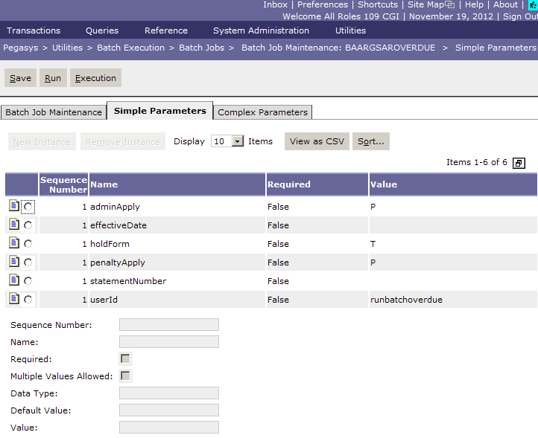
AROVERDUE – Simple Parameters
adminApply - Determines whether administrative charges are applied to only outstanding principal (value P) or total outstanding balance (value T)
penaltyApply - Determines whether penalty charges are applied to only outstanding principal (value P) or total outstanding balance (value T)
statementNumber - Allows AROVERDUE to be ran on one specific Statement
49

Slide 50
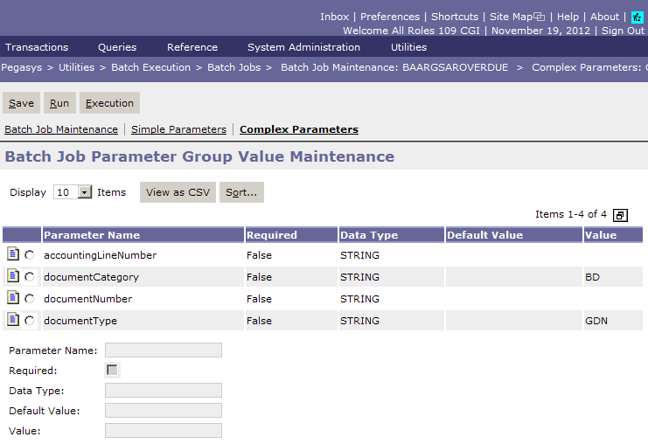
AROVERDUE – Complex Parameters
Values listed in Complex Parameters specify the BD Document Types to be selected by each batch instance for AROVERDUE assessment
50

Slide 51
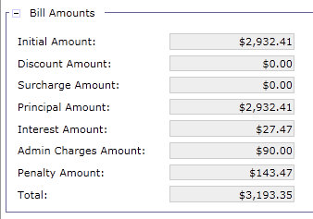
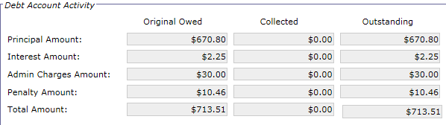
AROVERDUE Header Updates
Billing Document
Header Updates
Debt Account
Header Updates
51

Slide 52
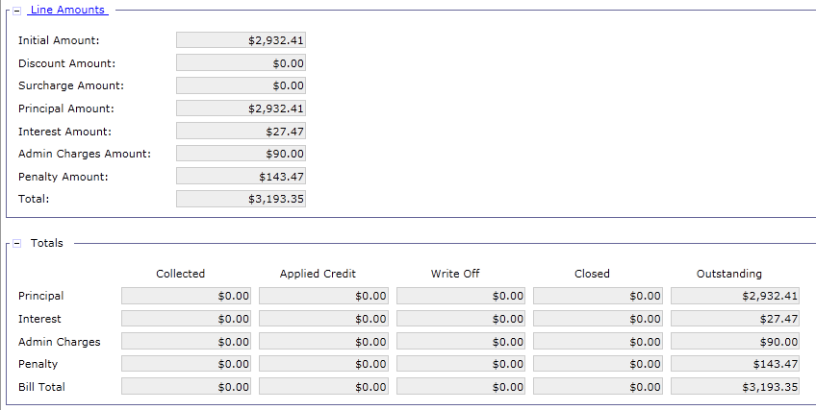
Billing Document Updates – Accounting Line
52

Slide 53
Debt Account Updates – Accounting Line

Slide 54
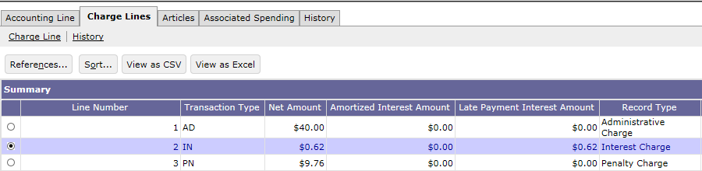
IP&A Charge Lines – Billing and Debt Account Documents
Billing Document Charge Line:
Recorded on a sub-tab of the BD Accounting Line
Records overdue IP&A charges associated with the Accounting Line
Debt Account Charge Line:
Recorded on a sub-tab of the DA Accounting Line
Records overdue IP&A charges associated with the Accounting Line
Records Amortization Schedule Interest
54

Slide 55
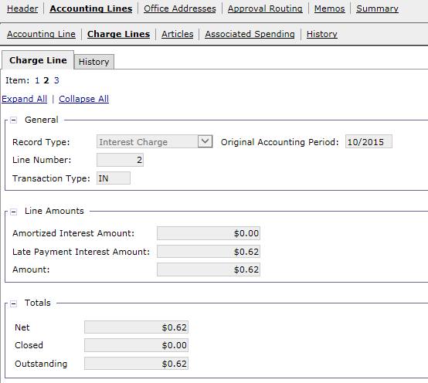
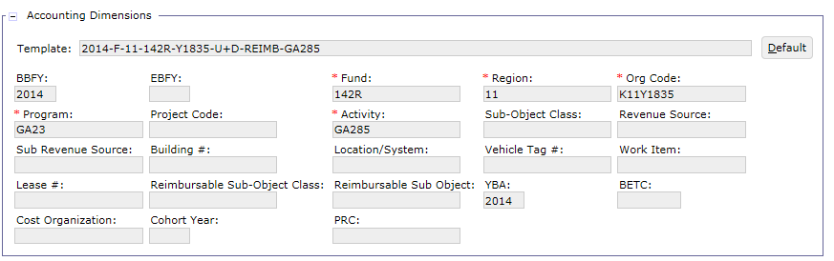
IP&A Charge Lines – Billing and Debt Account Documents
Record Type: Indicates the type of overdue charge: Interest, Penalty or Administrative Charge
Transaction Type: Determines the IP&A posting for the given Document Type; valid Transactions Types for IP&A are:
IN – Interest
PN – Penalty
AD – Administrative Charges
Line Amounts:
Amortized Interest Amount: Interest amount documented on current payment from referenced Amortization Schedule Code (Applicable only for Debt Accounts)
Late Payment Interest Amount – Amount charged to a customer when bill is not paid on time
Amount: Total of Amortized Interest Amount and the Late Payment Interest Amount
Accounting Template: Accounting Dimensions to be charged the IP&A charges
55

Slide 56
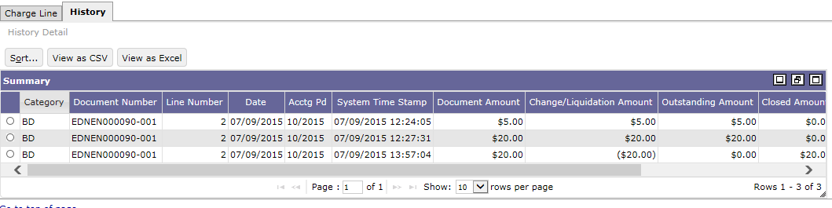
Charge Line – History
Tracks the dates and amounts of IP&A charge assessment and draw down
Charge Line History Tab shows both the original amount assessed and additional updates, including liquidation of overdue charges

Slide 57
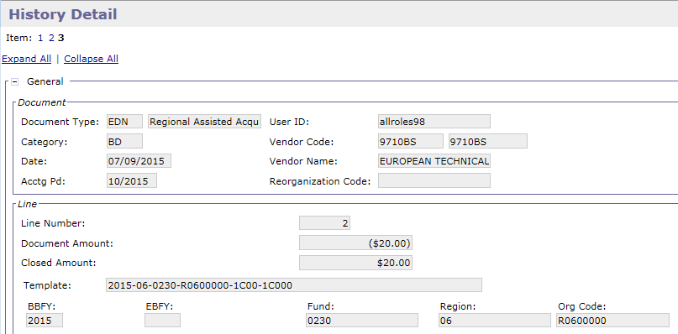
Charge Line – History Detail
Charge Line History Detail page shows the details of the Charge Line selected
In this example, this page shows the detail of the CR liquidating interest charge

Slide 58
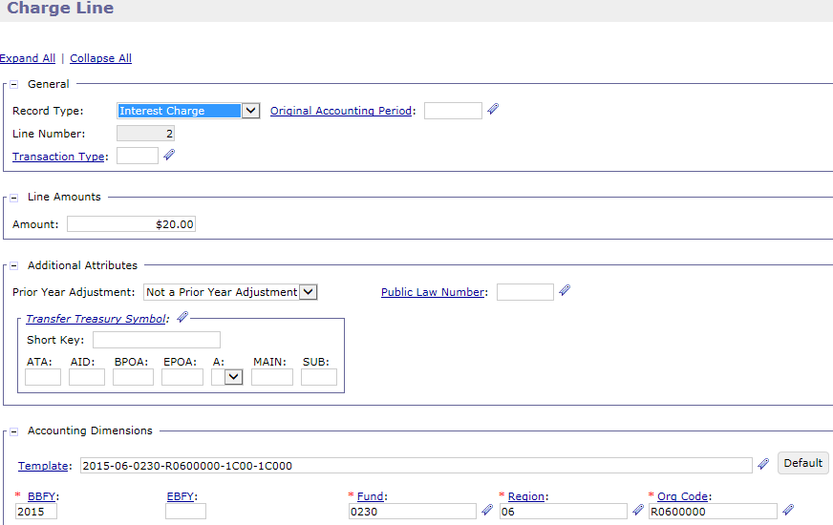
IP&A Charge Lines – Cash Receipt Documents
Cash Receipt Charge Line
Recorded on a sub-tab of the CR Accounting Line
Copied forward from the BD or DA
Records the collection of the overdue charges
Liquidates the overdue charges on the BD or DA
The posting order of the liquidation is established on the AR Options Maintenance table

Slide 59
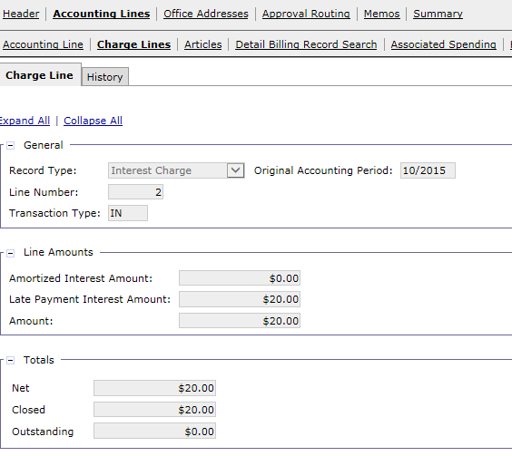
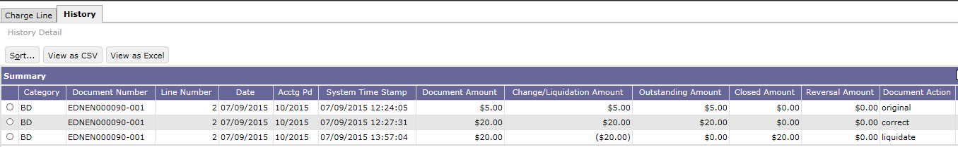
IP&A Charge Lines – BD Updates based on CR Liquidation
BD Charge Line updates
BD Charge Line History updates
59

Slide 60
Exercise
Exercise 2 – Review AROVERDUE updates to BD via Form/Document Selection
60

Slide 61
Statement Level Dunning
61

Slide 62
Delinquency and Receivables Management – Table of Contents
Segment 1: Delinquency and Receivables Management Overview
Segment 2: Outstanding Bills Query
Segment 3: Overdue Charges
Segment 4: Statement Level Dunning
Dunning Functionality
ARDUNNING Batch Process
Billing Document/Statement Impact
Segment 5: Non-IPAC Write-Offs
Segment 6: Correspondence and Non-IPAC Disputes
Segment 7: IPAC Chargebacks and Customer Generated Exceptions
Segment 8: PCAS Customer Novation
Segment 9: PCAS Unfilled Customer Order Reversal
Segment 10: Treasury Referral
Segment 11: Allowance for Loss
Segment 12: Treasury Report on Receivables (TROR)
62

Slide 63
Dunning Functionality – Overview
Pegasys generates Dunning Statements for Non-IPAC customers (vendor or designated agent level) with overdue account balances
Dunning Statements are generated for both:
Non-Federal customers
Non-IPAC Federal customers
A customer’s Dunning Statement shows:
Delinquent bill amounts, including principal and IP&A charges
Any payment or discount amounts received
Customers with multiple outstanding Receivables will have one Dunning Notice generated per Statement and Business Line
Configuration for the selection of records for dunning is specified on the General System Options and Accounts Receivable (AR) Options maintenance tables
63

Slide 64
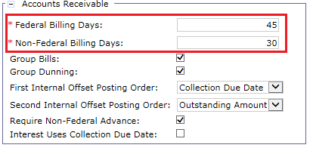
Dunning Functionality – General System Options Maintenance Table
General System Options settings used for dunning:
Federal Billing Days: Number of days after the Bill Print Date that the bill becomes due for Federal customers.
Used to set the Collection Due Date, if not manually entered on the bill.
Non-Federal Billing Days: Number of days after the Bill Print Date that the bill becomes due for Non-Federal customers.
Used to set the Collection Due Date, if not manually entered on the bill.
The Collection Due Date on the billing document is used to determine when to print the first dunning notice.
64

Slide 65
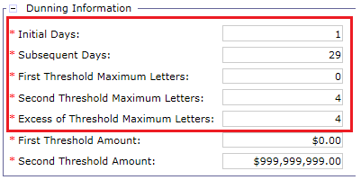
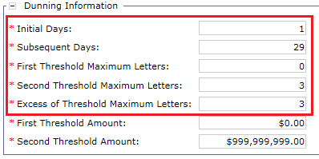
Dunning Functionality – AR Options Maintenance Table
Establishes different criteria for Non-Federal customers and Non-IPAC Federal customers, including:
Federal Dunning Criteria
Initial Days: Number of days after the Collection Due Date on which the first dunning letter should be generated.
Subsequent Days: Number of days used to determine the frequency for generating dunning notices after the first dunning notice is generated.
First Threshold Maximum Letters: Maximum number of dunning letters that should be produced for receivables with a principal total less than or equal to the First Threshold Amount
Second Threshold Maximum Letters: The maximum number of dunning letters that should be produced for receivables with a principal total less than or equal to the Second Threshold Amount
Excess of Threshold Maximum Letters: The maximum number of dunning letters that should be produced for receivables with a principal total greater than the Second Threshold Amount
Non-Federal Dunning Criteria
65

Slide 66
Dunning Functionality – Selection of Records
The Dunning batch process uses the information on the Billing Document and the AR Options maintenance table to select records for dunning, including:
Initial dunning notice:
Adds the Initial Dunning Days value specified on the AR Options maintenance table to the Collections Due Date on the Billing Document
If the resulting date is less than the Print Date parameter, a dunning statement is generated
Subsequent dunning notices:
Adds the Subsequent Days value specified on the AR Options maintenance table to the Last Print Date on the Billing Document
If the resulting date is less than the Print Date parameter, a dunning statement is generated
66

Slide 67
Dunning Functionality– Text Code Maintenance Table
Text printed on Dunning Notices is configured on the Text Code Maintenance table:
Note: First Demand Letter and subsequent Dunning Notice Generation for Debt Account will be covered in the Debt Account Lifecycle course
Business Line | Text Code
R6 Claims | R6POCLAIMS, R6PRCLAIMS, R6CLAIMS
AAS-ITS | AASITSNI, AASITSIPAC
External Services | EXTSRVNI
R7 Claims | R7CLAIMS
Outlease | OLNI
R7 Manual | R7MNLIPAC
R6 Manual | MNLBPI, MNLBPNI

Slide 68
Dunning Notice Generation Process - ARDUNNING
Automated Dunning Notice Generation Process - ARDUNNING
Automatically identifies overdue receivables and generates PDF Dunning Notices
ARDUNNING automatically triggers the Pegasys Notice of Payment Due report
If the process is interrupted or stopped, ARDUNNING can “pick up where it left off” via recovery ARDUNNING batch instance
An ARDUNNING batch instances and recovery batch instances exist for:
Non-Federal customers and Non-IPAC Federal customers
Configured per GSA Business Line
68

Slide 69
ARDUNNING Batch Process – Instances for Non-Federal Customers
Business Line | ARDUNNING Batch Process Codes for Non-Federal Customers
 | 1st Dunning Notice | Subsequent Dunning Notices | Recovery of 1st Notice | Recovery of Subsequent Notices
R6 Claims | ARDUNNINGR6C1NF | ARDUNINGR6C23NF | ARDUNINGR6C1NFR | ARDUNNGR6C23NFR
R6 Claims – Program Office | ARDUNNR6POC1NF | ARDUNNR6POC2NF | ARDUNNR6POC1NFR | ARDUNR6POC23NFR
R6 Claims – Payroll | ARDUNINGR6PR1NF | ARDUNNR6PR23NF | ARDUNNGR6PR1NFR | ARDUNNR6PR23NFR
AAS - ITS | ARDUNNAASITS1NF | ARDUNAASITS23NF | ARDUNAASITS1NFR | ARDNAASITS23NFR
External Service | ARDUNNES1NF | ARDUNNES23NF | ARDUNNES1NFR | ARDUNNES23NFR
R6 Manual | ARDUNNINGM1NF | ARDUNNINGM23NF | ARDUNNINGM1NFR | ARDUNNINGM23NFR
R7 Manual | ARDUNNINGR7ML1 | ARDUNNINGR7ML23 | ARDUNNINGR7ML1R | ARDUNINGR7ML23R
Outlease | ARDUNNINGOL1NF | ARDUNNINGOL23NF | ARDUNNINGOL1NFR | ARDUNINGOL23NFR
R7 Claims | ARDUNNINGR7C1NF | ARDUNINGR7C23NF | ARDUNINGR7C1NFR | ARDUNNGR7C23NFR

Slide 70
ARDUNNING Batch Process – Instances for Non-Federal Customers
Business Line | ARDUNNING Batch Process Code Non-IPAC Federal Customer
 | 1st Dunning Notice | Subsequent Dunning Notices | Recovery for 1st Notice | Recovery for Subsequent Notices
AAS - ITS | ARDUNNAASITS1F | ARDUNAASITS234F | ARDUNNAASITS1FR | ARDNAASITS234FR
External Service | ARDUNNES1F | ARDUNNES234F | ARDUNNES1NFR | ARDUNNES23NFR
70

Slide 71
ARDUNNING Batch Process – The Notice of Payment Due Report
PDF Dunning Notice reports are attached to the corresponding statement in both Pegasys and VCSS
Includes the bill date, bill number, amount billed, outstanding amount and collected amount by GSA
Sorted by vendor and BD number in ascending order

Slide 72
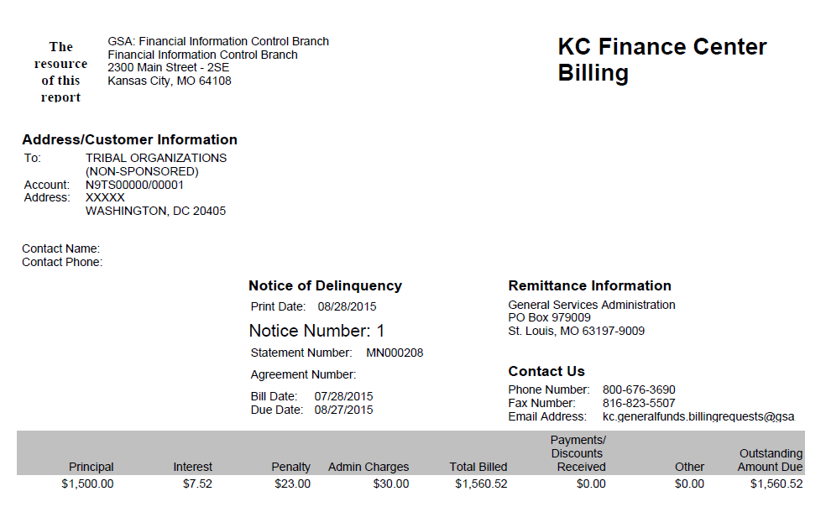
ARDUNNING Batch Process – Dunning Notice – Page 1 Example
72

Slide 73
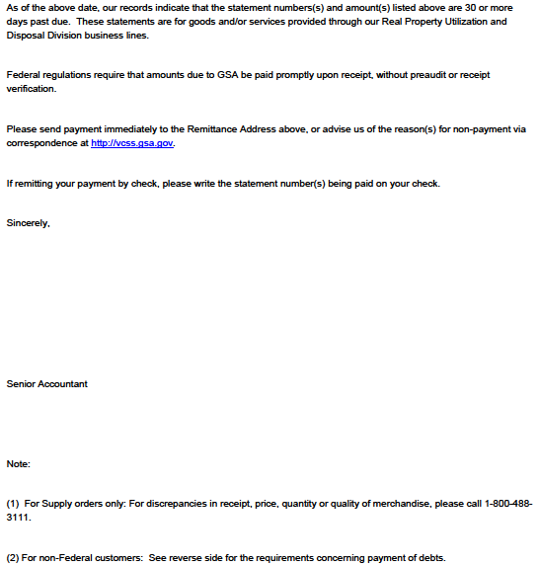
ARDUNNING Batch Process – Dunning Notice – Page 2 Example
73

Slide 74
Billing Document and Statement Impact
GSA determines whether or not to dun customers based on Document Type or at the individual bill level
The Dunning Print Flag on the BD Accounting Line determines if Dunning Statements will generate
If Debt Appeal/Forbearance flag is True on the BD Accounting Line, the BD line will not be dunned
The Debt Appeal/Forbearance flag is checked when a customer has formally submitted a dispute against their statement
Combination of:
Collection Due Date on the Billing Document
Configuration of the AR Options Maintenance table
Determines the dunning dates and eligibility
Note: IPAC Document Types, Revenue Credit Card, and DoD interfund billings are not set up to dun in Pegasys

Slide 75
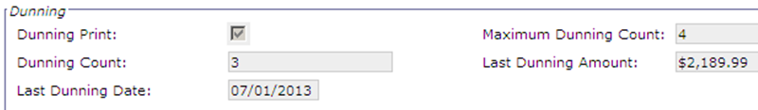
Billing Document and Statement Impact
For a Dunned Bill, BD Accounting Line updates include:
Dunning Count with number of Dunning Notices sent
Last Dunning Date with date of the last Dunning Notice sent
Last Dunning Amount with amount of the last Dunning Notice sent

Slide 76
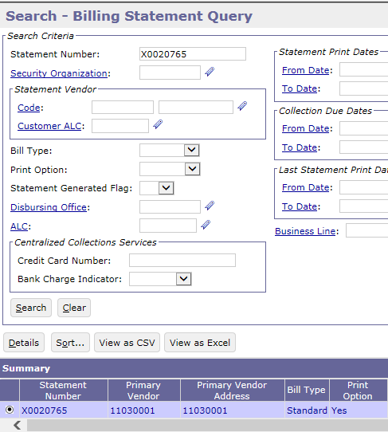
Billing Document and Statement Impact
To view updates to Billing Statement
Queries->Receivables->Billing Statement Query
Enter Statement Number and then select Search
Select Billing Statement in Item Collection
Select Details button

Slide 77
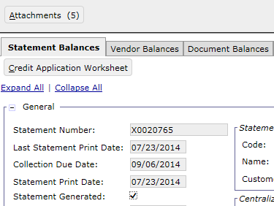
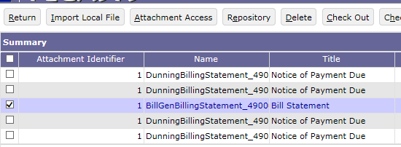
Billing Document and Statement Impact
Select the Attachments Button
The number in parenthesis indicates the Bill and number of Dunning Notices generated
Select the Bill or a Dunning Notice from the Item Collection
Select Attachment Access to view selected item

Slide 78
Non-IPAC Write-Offs
78

Slide 79
Delinquency and Receivables Management – Table of Contents
Segment 1: Delinquency and Receivables Management Overview
Segment 2: Outstanding Bills Query
Segment 3: Overdue Charges
Segment 4: Statement Level Dunning
Segment 5: Non-IPAC Write-Offs
Non-IPAC Write-Offs
Segment 6: Correspondence and Non-IPAC Disputes
Segment 7: IPAC Chargebacks and Customer Generated Exceptions
Segment 8: PCAS Customer Novation
Segment 9: PCAS Unfilled Customer Order Reversal
Segment 10: Treasury Referral
Segment 11: Allowance for Loss
Segment 12: Treasury Report on Receivables (TROR)
79
Notes:
GSA is going to identify BDs eligible for write off using the aged receivables report and the
2) Based on the info from that report (ex: $100 ) , right before they generate the write off CR, they are going to look up the statement on the outstanding bills query so they can see the current outstanding amount
3) Generate the write off CR
IPAC write-offs will be discussed later in the course

Slide 80
Non-IPAC Write-Offs – Overview
Non-IPAC Receivables outstanding amounts may be written-off manually if the bill is deemed uncollectible by GSA
GSA uses the Aged Receivable Report to identify eligible statements to be written off
Report output is formatted as a csv file
Includes the number of days the receivable is delinquent
Pegasys Outstanding Bills Query provides additional details regarding the outstanding amount to be written off
Fund | BBFY | Business Line | Reg | Document Number | Vendor | Agreement Number | Asgn Cd | Amount | Bill Date | Days Old | Del Days
142R | 2014 | R6MANUAL | 11 | MDNMN000106-001 | 56302A | MBD001-14 | MNLBL | 34000 | 7/22/2014 | 258 | 213
142R | 2014 | R6MANUAL | 11 | MDNMN000110-001 | 54301A | MBF002-14 | MNLBL | 1000 | 7/22/2014 | 258 | 213
142R | 2014 | R6MANUAL | 11 | MDNMN000116-001 | 56302A | MBD001-14 | MNLBL | 34000 | 8/21/2014 | 228 | 183
142R | 2014 | R6MANUAL | 11 | MDNMN000119-001 | 54301A | MBF002-14 | MNLBL | 1875 | 8/21/2014 | 228 | 183
142R | 2014 | R6MANUAL | 11 | MDNMN000122-001 | 56302A | MBD001-14 | MNLBL | 17000 | 9/23/2014 | 195 | 150
142R | 2014 | R6MANUAL | 11 | MDNMN000130-001 | 56302A | MBD001-14 | MNLBL | 17000 | 10/22/2014 | 166 | 121

Slide 81
Non-IPAC Write-Offs – Overview
Pegasys Cash Receipt (CR) document with a Line Type of Write-Off records the write-off transaction and triggers:
Billing Document and related statement entity updates
PCAS Agreement updates
PCAS Agreement Query tracks written-off receivables associated with each agreements
Workflow approval
Approval Routing is based on Write-Off amount and GSA Policy Write-Off Thresholds for Federal and Non-Federal receivables

Slide 82
Non-IPAC Write-Offs – Manual Generation
Manual Non-IPAC Write-Off Process
Identify statements to be written off via the Aged Receivables Report
Information displayed on report is current through the previous day from which the report was run
May not show collections received against statements after generation
Verify the statement, BD, and Accounting Line amounts to be written off via the Outstanding Bills Query
Manually generate the Write-off CR
82

Slide 83
Non-IPAC Write-Offs – CR Document Types
Different Document Types are used for Federal versus Non-Federal Write-offs
Region | Non-IPAC Federal Write-Off Document Type | Non-Federal Write-Off Document Type
6 | WO6 | NW6
7 | WO7 | NW7
83

Slide 84
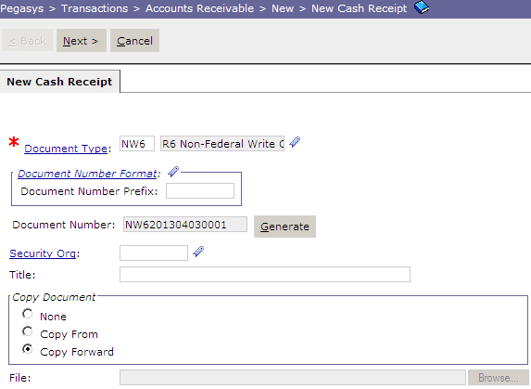
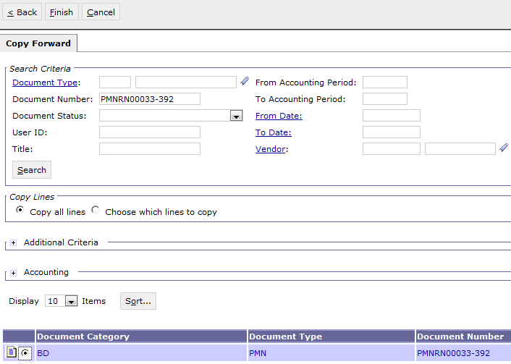
Non-IPAC Write-Offs – Cash Receipt with Line Type of Write-Off
Create a Cash Receipt with a Line Type of Write-off
Pegasys > Transactions > Accounts Receivable > New > New Cash Receipt
Copy Forward the Outstanding BD to create the Write-Off CR
84

Slide 85
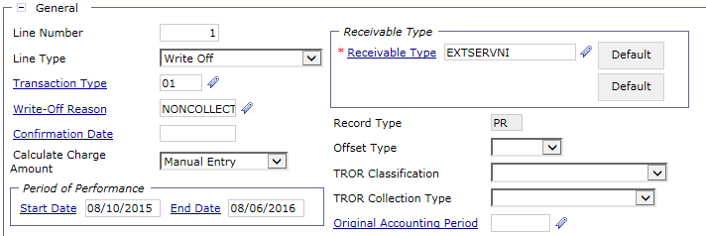
Non-IPAC Write-Offs – CR Accounting Line
On CR Accounting Line, set Line Type - Write Off
Enter Transaction Type - 01
85

Slide 86
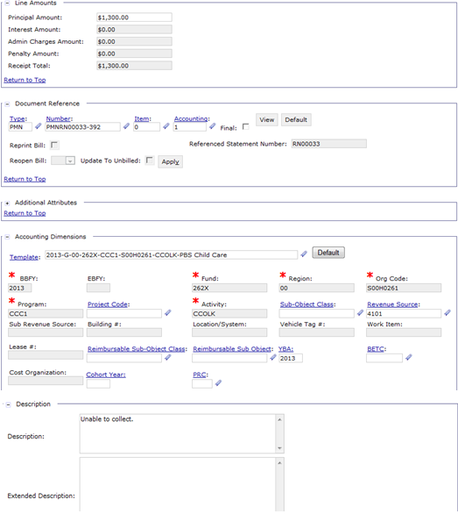
Non-IPAC Write-Offs– CR Accounting Line
Line Amounts - BD accounting line amounts to be written-off (principal + IP&A amounts)
Document Reference - BD document number, accounting line number, and statement number to be referenced for Write-Off
Accounting Dimensions – Pulled from the BD accounting line
Description - Required at the accounting line level when processing Write-Off CR
86

Slide 87
Non-IPAC Write-Offs - Region 6/7 Required Approvals Federal Write-Off Thresholds
Approval routing of write-off documents is based on the write-off amount and GSA policy write-off thresholds
All R6/7 Federal Write-Off Approvers:
Min ($) | Max ($) | Approval 1 | Approval 2 | Approval 3 | Approval 4 | Approval 5
50.01 | 1,000 | Technical Matter Expert
1,000.01 | 5,000 | “ | Manager
5,000.01 | 10,000 | “ | “ | Branch Chief
10,000.01 | 20,000 | “ | “ | “ “ | Division Director
20,000.01 |  | “ | “ | “ “ | “ “ | Director Financial Policy and Operations
87

Slide 88
Non-IPAC Write-Offs - Region 6/7 Required Approvals Non-Federal Write-Off Thresholds
Approval routing of write-off documents is based on the write-off amount and GSA policy write-off thresholds
All R6/7 Non-Federal Write-Off Approvers:
Min ($) | Max ($) | Approval 1 | Approval 2 | Approval 3 | Approval 4 | Approval 5
50.01 | 1,000 | Technical Matter Expert
1,000.01 | 10,000 | “ | Manager
10,000.01 | 50,000 | “ | “ | Branch Chief
50,000.01 | 100,000 | “ | “ | “ “ | Division Director
100,000.01 |  | “ | “ | “ “ | “ “ | Director Financial Policy and Operations
88

Slide 89
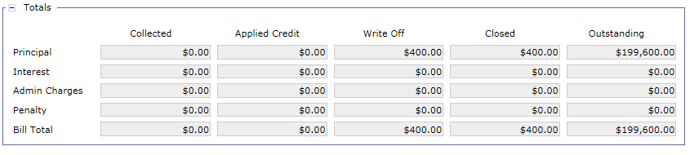
Non-IPAC Write-Offs – BD Updates

Slide 90
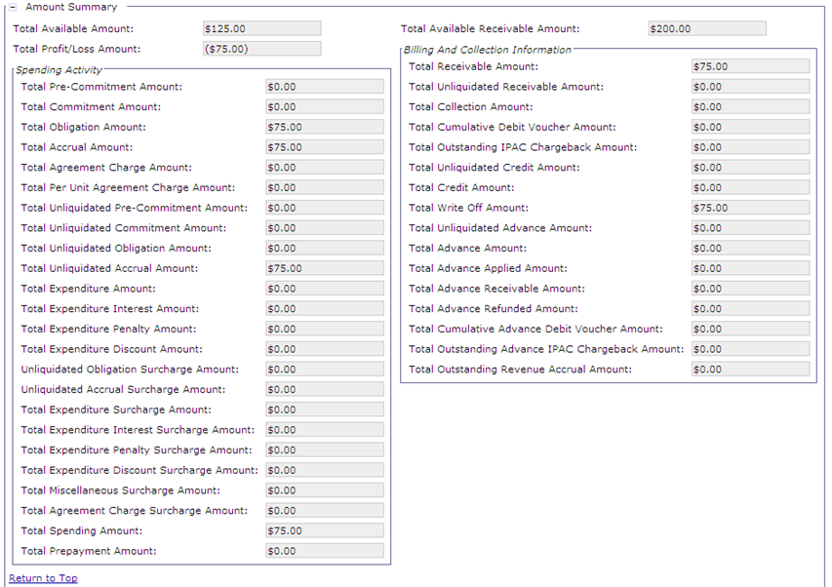
Non-IPAC Write Offs - Agreement Updates PCAS Agreement Query Header
Total Available Receivable Amount:
Agreement established for $200
Total Spending Amount:
Receipt processed for $75
Total Receivable Amount:
Receivable recorded for $75
Total Write Off Amount:
Write Off processed for $75
Total Profit/Loss Amount:
Loss recorded for $75 for the Write Off Amount
Total Available Amount:
Agreement Amount reduced by the Write Off
($200-75=$125)
90

Slide 91
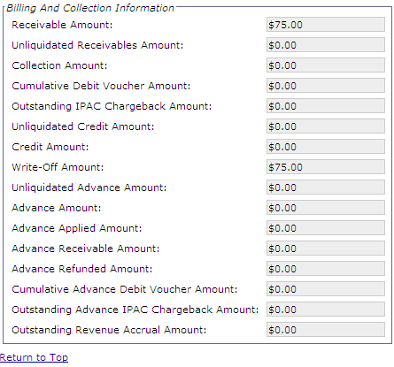
Non-IPAC Write Offs - Agreement Updates PCAS Agreement Query Line – Write Offs
91

Slide 92
Exercise
Exercise 3 – Region 6 – Create Write-Off CR and Review Updates to the referenced BD and Agreement

Slide 93
Non-IPAC Correspondence and Disputes
93

Slide 94
Delinquency and Receivables Management – Table of Contents
Segment 1: Delinquency and Receivables Management Overview
Segment 2: Outstanding Bills Query
Segment 3: Overdue Charges
Segment 4: Statement Level Dunning
Segment 5: Non-IPAC Write Offs
Segment 6: Correspondence and Non-IPAC Disputes
Correspondence
Non-IPAC Disputes
Segment 7: IPAC Chargebacks and Customer Generated Exceptions
Segment 8: PCAS Customer Novation
Segment 9: PCAS Unfilled Customer Order Reversal
Segment 10: Treasury Referral
Segment 11: Allowance for Loss
Segment 12: Treasury Report on Receivables (TROR)
94

Slide 95
Correspondence – Overview
Correspondence provides GSA with the ability to:
Initiate communication with the customer
Respond to customer initiated communication
Record and track customer communication
Maintain the history of communication with the customer
Associate correspondence records to statements, vendor records and documents in Pegasys
Correspondence supports:
Internal communication within GSA
Communication between GSA and Customers using Pegasys and VCSS
The ability to add attachments to the correspondence record
Emailing capabilities from Pegasys
95

Slide 96
Correspondence – Overview
Two Sources of Correspondence
Pegasys: GSA initiated correspondence
VCSS: Customer initiated correspondence
When correspondence is created in VCSS, a user will receive a workflow notification task in their Pegasys Inbox
Three Types of Correspondence
Document Correspondence
Statement Correspondence
Account Correspondence
96
Notes:
When sending correspondence as an email to the customer, Pegasys users should include their official email address so that the correspondence is also sent to their inbox.

Slide 97
Document Correspondence
Document Correspondence records communication related to a specific document in Pegasys:
Can be generated for Debt Account (DA), Itemized Payments (IP), Internal Vouchers (NV), or Cash Receipts (CR)
Correspondence related to a billing is recorded on the Billing Statement as Statement Level Correspondence and not on the Billing Document (BD)
Form/Document Selection allows Pegasys user to search and open a document to create correspondence message
Correspondence can be shared with Pegasys users or emailed/transmitted to VCSS for external customer to view
Document Level Correspondence can also be received from external customers via VCSS
97

Slide 98
Document Correspondence Process
To create Document Correspondence:
Pegasys > Transactions > Form/Document Selection
Enter query criteria in the Search Criteria section (be as detailed as possible in order to maintain system integrity) and click “Search”
Select item and select “View”*
Select “Correspondence” tab and Select “Add”
Select the new record and populate with pertinent correspondence information
Select “Save”
* Document level correspondence can be created and/or viewed by GSA users while:
Creating a new DA/IP/NV/CR document, or
Reviewing an existing DA/IP/NV/CR document
98

Slide 99
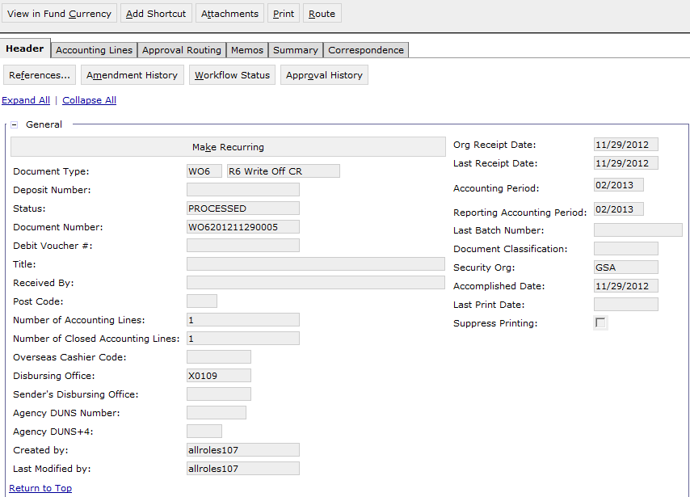
Document Correspondence
99

Slide 100
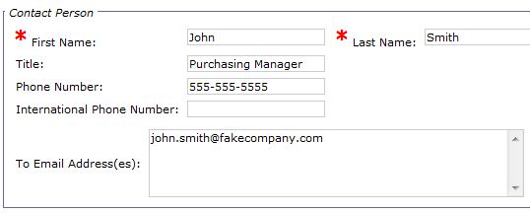
Document Correspondence – Contact Person Section
First Name - The first name of the customer contacting GSA
Last Name - The last name of the customer contacting GSA
Title - The job title of the customer contacting GSA
Phone Number - The phone number of the customer contacting GSA
To Email Address(es) - The email address(es) of the customer contacting GSA and to which the correspondence should be emailed to (if the GSA user uses the correspondence email capability
100
CGI Federal Proprietary and Confidential

Slide 101
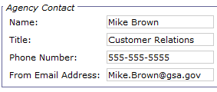
Document Correspondence – Agency Contact Section
Name - The user ID of the GSA contact creating the record
Title - The job title of the GSA contact
Phone Number - The phone number of the GSA contact
From Email Address - The email address of the GSA contact
101
CGI Federal Proprietary and Confidential

Slide 102
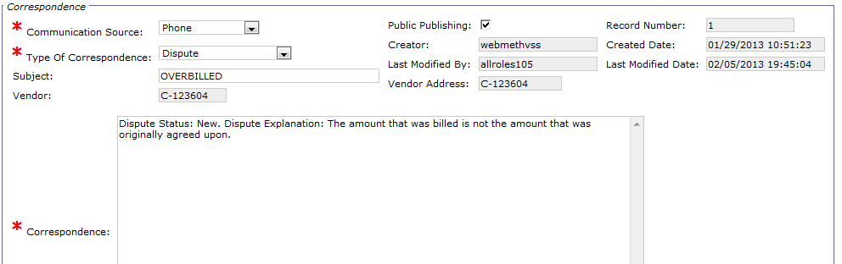
Document Correspondence – Agency Contact Section
Communication Source - A drop down box containing communication medium options (External System, Fax, Mail/Email, Phone or VCSS)
Public Publishing - Setting the flag to true specifies the correspondence record to be emailed/transmitted to VCSS for external customer to view
Type of Correspondence - A drop down box containing correspondence types (Resolution, Communication, Question, Chargeback, Chargeback - Resolution, Dispute or Other)
Subject - The subject of the message/memo/correspondence
Vendor/Address Code - The vendor code or vendor’s address code
Correspondence - The message/memo/correspondence
Note: Upon selecting Save, the following Correspondence fields are auto-populated: Vendor Email Address, Record Number, Statement Number, Creator, Created Date, Last Modified By and Last Modified Date
102
CGI Federal Proprietary and Confidential

Slide 103

Document Correspondence
103

Slide 104
Document Correspondence
Field Name | Description
Contact Person Section
First/Last Name | The first/last name of the customer/debtor
Title | The job title of the customer/debtor
Phone Number | The phone number of the customer/debtor
To Email Address(es) | The email address(es) of the customer/debtor and to which the correspondence should be emailed (if the Pegasys user utilizes the correspondence email capability).
Agency Contact Section
Name | The user ID of the GSA contact creating the record.
Title | The job title of the GSA contact.
Phone Number | The phone number of the GSA contact.
From Email Address | The email address of the GSA contact.
Correspondence Section
Communication Source | A dropdown box containing communication mediums. Options include: External System, FAX, Mail or Email, Phone, VCSS
Type of Correspondence | A dropdown box containing correspondence types. Options include: Resolution, Communication, Question, Chargeback, Chargeback Resolution, Dispute, and Other.
Subject | The subject header used to describe the correspondence.
Correspondence | Text field used to enter any text/information relating to the correspondence record.
Public Publishing Flag | Setting the flag to true specifies the correspondence record to be emailed/transmitted to VCSS for external customer to view. This flag is set to false for Debt Account correspondence because DA correspondence is not transmitted to VCSS.

Slide 105
Statement Correspondence
Statement Correspondence allows Pegasys user and GSA VCSS customer to correspond about a specific Billing Statement in Pegasys
Billing Statement query allows Pegasys user to search and open a statement to create or view correspondence messages
Correspondence can be shared with Pegasys users or emailed/transmitted to VCSS for external customer to view
Statement Level Correspondence can also be received from external customers via VCSS
Submission of billing dispute request automatically generates Statement Correspondence for the Billing Statement associated with the request
Automatic generation of Dispute Correspondence does not trigger an email to the customer
New dispute request can be viewed by the customer in VCSS via the VCSS View Dispute Requests Query
105

Slide 106
Statement Correspondence Process
To create Statement Level Correspondence:
Pegasys > Queries > Accounts Receivable > Billing Statement Query
Enter query criteria in the Search Criteria section (be as detailed as possible in order to maintain system integrity) and click “Search”
Select item and select “Details”
Select “Correspondence” tab and Select “Add”
Select the new record and populate with pertinent correspondence information
Select “Save”
106

Slide 107

Statement Correspondence
107

Slide 108

Statement Correspondence
108

Slide 109
Account Correspondence
Account Correspondence documents communication related to the overall customer account (i.e. vendor code) in Pegasys
Information documented is not directly related to a document or statement
Vendor Activity query allows Pegasys user to search and open a vendor record to create or view correspondence message
Correspondence can be shared with Pegasys users or emailed/transmitted to VCSS for external customer to view
Account Level Correspondence can also be received from external customers via VCSS
109

Slide 110
Account Correspondence Process
To create Account Level Correspondence:
Pegasys > Queries > Vendor > Vendor Activity Query
Enter query criteria in the Search Criteria section (be as detailed as possible in order to maintain system integrity) and click “Search”
Select item and select “Details”
Select “Account Summary” tab
Select “Address Amounts”
Select item and select “Correspondence”
Select “Add”
Select the new record and populate with pertinent correspondence information
Select “Save”
110

Slide 111

Account Correspondence
111

Slide 112

Account Correspondence
112
CGI Federal Proprietary and Confidential

Slide 113
Account Correspondence
113

Slide 114

Account Correspondence
114

Slide 115

Account Correspondence
115

Slide 116
Non-IPAC Disputes
Pegasys Dispute functionality provides GSA customers the ability to electronically submit dispute requests while reviewing billing information in Vendor Customer Self Service (VCSS)
VCSS provides a single location for customers and financial analysts to access billing information
Most disputes originate from VCSS
Disputes can be submitted for the total statement amount or specific Detail Billing Records
Because Outlease, External Services, and the Manual Business Lines do not use the detail billing record functionality, these customers can only submit dispute requests via VCSS at the statement level
Dispute requests may be received for bills that have already been partially or fully collected
116

Slide 117
Non-IPAC Disputes Lifecycle
GSA submits bill to customer
Customer disputes bill in VCSS (BDs only)
Pegasys receives dispute notification
Dispute is reviewed for action needed
Dispute resolution
117

Slide 118
Non-IPAC Disputes via VCSS
Each new dispute request received from VCSS automatically:
Creates a dispute record in Pegasys viewable on the Disputed Billings Query
Generates a Review Billing Dispute Request workflow notification task in Pegasys
Task is routed to appropriate Pegasys user based on the Assignment Code recorded on the BD associated with the dispute request
Once the status of the dispute is updated, the workflow task is completed and removed from the Inbox
Generates a Customer Correspondence entry in Pegasys, associates with corresponding billing statement
118

Slide 119
Non-IPAC Disputes – Disputed Billings Workflow Notification Task
When a dispute request is generated and recorded on the Disputed Billings Query (as a result of submission from VCSS):
A new Review Billing Dispute Request workflow task is created and routed using Pegasys workflow capabilities
Based on Assignment Code recorded on BD associated with dispute
Includes information specific to the dispute request:
Customer/Vendor Code/Name
Disputed Document Number
Disputed Statement Number
Provides Pegasys user the ability to view related dispute object from Disputed Billings Query
119

Slide 120


Non-IPAC Disputes – Disputed Billings Workflow Notification Task
To address disputes in workflow:
Navigate to Inbox
From the Task dropdown, select “Review Billing Dispute Request”
Select “Search”
Select item
Select “Acquire”
120

Slide 121

Non-IPAC Disputes – Disputed Billings Workflow Notification Task
Select View billing Dispute Request from the acquired notification task:
121

Slide 122

Non-IPAC Disputes – Disputed Billings Workflow Notification Task
Review dispute via the Disputed Billings Query
View related billing dispute information
Update the dispute status
View/correct/amend the associated BD/Internal Voucher
122

Slide 123
Non-IPAC Disputes – Dispute Statuses
Once the status of the dispute is updated, the workflow task is completed and removed from the Inbox
Dispute Status | Description
New Dispute | Dispute received from VCSS or created by a Pegasys user, analysis has not begun
Under Review | Pegasys user has initially reviewed the dispute request and is currently performing a full analysis to determine whether it should be accepted or rejected
Pending Final Action | Analysis of the dispute is complete and is currently awaiting a BD correction to finalize the acceptance or rejection
Accepted | Dispute request has been fully analyzed and transaction updates have occurred in Pegasys to reflect the acceptance of the dispute
Rejected | Dispute request has been fully analyzed and transaction updates have occurred in Pegasys to reflect the rejection of the dispute
123

Slide 124
Non-IPAC Disputes – Disputed Billings Query – Key Attributes
Provides the ability to manage dispute requests received from VCSS
View related billing dispute information
Update the dispute status
View/correct/amend the associated BD/Internal Voucher
Provides the ability to search for existing dispute requests
Provides the ability to manually create new dispute requests
Dispute requests may be received for bills that have already been partially or fully collected
124
Notes:
The Dispute Resolution Date is automatically set to the date the dispute status was updated to Rejected.
Disputed bills can have collections posted against them.

Slide 125

Non-IPAC Disputes – Disputed Billings Query – Research Existing Disputes
Disputed Billings Query also provides the ability to search for existing dispute requests. To query an existing dispute:
Pegasys > Queries > Accounts Receivable > Disputed Billings Query
Enter query criteria (vendor code, document number, etc.) and click “Search”
125

Slide 126

Non-IPAC Disputes – Disputed Billings Query – Research Existing Disputes
Select item and select “Details”
126

Slide 127


Non-IPAC Disputes – Disputed Billings Query – Research Existing Disputes
127

Slide 128
Non-IPAC Disputes – Disputed Billings Query – Record Dispute Button
If after initial evaluation, the Pegasys user deems that a dispute requires further investigation, the Record Dispute Button functionality on the Disputed Billings Query can be used to update the Dispute Status
Used by Pegasys user when updating dispute status from New to Under Review
Automatically updates the BD of a corresponding dispute request
Update will occur as a document “amendment”
Prevents system from generating dunning notices for disputed amount
Prevents system from assessing additional Interest/Penalty/Admin Charges
Record Dispute – Dispute of entire BD or of select Accounting Lines:
Sets Debt Appeal Forbearance Flag to True on all Accounting Lines included in dispute
Dunning notices are not generated on documents where the Debt Appeal Forbearance flag is True
Captures the Debt Appeal Forbearance Date on all Accounting Line(s)
128

Slide 129
Non-IPAC Disputes – Disputed Billings Query – Record Dispute Button
Record Dispute – Dispute of Detail Billing Record(s):
Locates the Accounting Line(s) with the disputed Detail Billing Records(s)
Reduces the Accounting Line by the total amount of disputed Detail Billing Record(s)
Generates a new Accounting Line
Sets the Debt Appeal Forbearance Flag on the new Accounting Line to True
Captures the Debt Appeal Forbearance Date on the new Accounting Line
Transfers the Detail Billing Record(s) specified in the billing dispute request from the original Accounting Line to the new Accounting Line
Because Outlease, External Services, and the Manual Business Lines do not use the detail billing record functionality, these customers can only submit dispute requests via VCSS at the statement level
129

Slide 130
Non-IPAC Disputes – Disputed Billings Query – Remove Dispute Button
Upon the completion of investigating the dispute, the Remove Dispute Button functionality on the Disputed Billings Query:
Automatically updates the BD of a corresponding dispute request
Update will occur as a document “amendment”
Used after Pegasys user has completed review, status set to Pending Final Action, Accepted, or Rejected
Remove Dispute – Dispute of entire BD:
Sets the Debt Appeal Forbearance Flag to False on all Accounting Lines
Removes the Debt Appeal Forbearance Date from all Accounting Lines
Remove Dispute – Dispute of Detail Billing Record(s):
Locates the Accounting Line(s) with the disputed Detail Billing Record(s)
Sets the Accounting Line Debt Appeal Forbearance Flag to False
Clears the Accounting Line Debt Appeal Forbearance Date field
After Dispute removal, Dunning and AROVERUE:
Re-calculate IP&A based on original date if dispute is not resolved in debtor’s favor
130

Slide 131

Non-IPAC Disputes – Disputed Billings Query – Creating New Disputes
The Disputed Billings Query can be used to create new disputes directly in Pegasys on the customer’s behalf
Navigate to Queries > Accounts Receivable > Disputed Billings Query and select “New”
131

Slide 132

Non-IPAC Disputes – Disputed Billings Query – Creating New Disputes
Billing Document/Internal Voucher page: Enter the Document Type/Document Number of the document to be disputed, choose Dispute Type and select “Next”
132

Slide 133

Non-IPAC Disputes – Disputed Billings Query – Creating New Disputes
Choose Detail Records page: Search for and select the Detail Billing Records to be included in the dispute request and select “Next”
Note: The Choose Detail Records page is only displayed if
“Choose Which Detail Records to Dispute” is selected as the Dispute Type
133

Slide 134

Non-IPAC Disputes – Disputed Billings Query – Creating New Disputes
Supplementary Dispute Information page: Fill required Customer Contact Information and Supplementary Dispute Information fields and select “Next”
134

Slide 135

Non-IPAC Disputes – Disputed Billings Query – Creating New Disputes
Disputed Items Review page: Review selected items to be disputed and select “Submit Dispute Request”
135

Slide 136
Non-IPAC Disputes – Dispute Correspondence
Submission of a billing dispute request automatically generates a Customer Correspondence entry
Recorded against the Billing Statement associated with the request (i.e. Statement Level correspondence)
Automatic generation of this Customer Correspondence entry does not trigger an email to the customer
The new dispute request can be viewed by the customer in VCSS via the VCSS View Dispute Requests Query
136

Slide 137
IPAC Chargebacks and Customer Generated Exceptions
137

Slide 138
Delinquency and Receivables Management – Table of Contents
Segment 1: Delinquency and Receivables Management Overview
Segment 2: Outstanding Bills Query
Segment 3: Overdue Charges
Segment 4: Statement Level Dunning
Segment 5: Non-IPAC Write Offs
Segment 6: Correspondence and Non-IPAC Disputes
Segment 7: IPAC Chargebacks and Customer Generated Exceptions
IPAC Chargebacks
Customer Generated Exceptions
Segment 8: PCAS Customer Novation
Segment 9: PCAS Unfilled Customer Order Reversal
Segment 10: Treasury Referral
Segment 11: Allowance for Loss
Segment 12: Treasury Report on Receivables (TROR)
138

Slide 139
IPAC Chargebacks – Overview
Chargebacks as defined by Treasury (“Adjustments”):
If a customer agency disagrees with an IPAC transaction sent from GSA, they “charge back” the transaction
Treasury calls chargebacks “Adjustments”:
An Adjustment is a transaction the customer agency initiates to adjust an erroneous or incorrect payment or collection
Customer agencies can only use adjustments to reduce (adjust down) the original transaction amount
Customer agencies can only process an adjustment against a payment or collection that is 90 days old or less from the age of the transaction’s accomplished date
90 Day Window - Treasury limits adjustment transactions to 90 days of the original transaction’s accomplish date
Note: Detailed processes related to IPAC Chargebacks will be covered in the IPAC Lifecycle course

Slide 140
IPAC Chargebacks – Overview
Types of chargebacks (collection versus payment adjustments):
Collection Adjustment – GSA receives an adjustment from a customer on a bill GSA sent to the customer
GSA's customer charges back the billing sent by GSA - Customer “takes” money back from GSA
Payment Adjustment – GSA receives an adjustment from a customer on a payment GSA sent to the customer
GSA sends a credit to the customer that the customer decides to send back to GSA

Slide 141

IPAC Chargebacks – Collection Adjustments
A Collection Adjustment is created by a customer when they do not agree with the IPAC bill received from GSA
Customer creates a “Billing Adjustment” in IPAC
GSA receives a “Collection Adjustment” from IPAC
Collection Adjustments are received in the Treasury IPAC Accomplishment Report and processed in Pegasys using IPAC Inbound
Pegasys creates the Collection Adjustment as a Cash Receipt transaction with a Debit Voucher line type
Collection Adjustments can be: Rebilled, Accepted, Written-Off

Slide 142
IPAC Chargebacks – Collection Adjustments
GSA bills Customer Agency for $500 via IPAC
A Collection is received via IPAC for the full Amount $500
The Customer Agency then feels that the full $500 bill was erroneous
The Customer Agency initiates a Chargeback through IPAC
GSA receives this Collection Adjustment as a CR Debit Voucher
The Debit Voucher line type references the original collection (Cash Receipt document)
The Debit Voucher line type reopens the original Billing Document
The billing status for IPAC BDs changes from billed to unbilled
The billing status for non-IPAC BDs remains billed

Slide 143

IPAC Chargebacks – Collection Adjustments
Example: Updates to BD – Header

Slide 144

IPAC Chargebacks – Collection Adjustments
Example: IPAC BD Rebill Article – Item Collection

Slide 145


IPAC Chargebacks – Collection Adjustments
Example: Updates to PCAS Agreement (via Agreement Query)

Slide 146
IPAC Chargebacks – Collection Adjustments
IPAC Inbound Processing: Cash Receipt Debit Voucher
Rebill Article
Chargebacks can be:
Rebilled - To Rebill, the Rebill Article IPAC Status is manually changed from Hold Pending Chargeback to “Not Submitted”
Accepted - To accept a chargeback:
No agreement reference – The Rebill Article IPAC Status is manually changed from Hold Pending Chargeback to “Do Not Send”, reducing receivable
Agreement reference – Corrections are performed at the agreement level (for recurring - flat rate), the agreement charge level (for recurring - AG), or the spending level (non-recurring) , which are carried forward to a credit bill
The Rebill Article on the chargeback BD is then manually changed from Hold Pending Chargeback to “Not Submitted” to rebill
Written-Off - To Write-Off an IPAC chargeback, the IPAC Transaction Query is used to record Write-Off amounts and generate the write-off Cash Receipt transaction

Slide 147
IPAC Chargebacks – Payment Adjustments
A Payment Adjustment is created when GSA sends a refund to a customer agency but the customer agency does not accept the refund
Refund payments are sent to customers for IPAC credit bills
Customers may refuse the refund payment for the credit bill
If a customer agency does not accept the refund, they chargeback the refund
The customer generates a payment adjustment in IPAC to "chargeback" a refund payment transaction from GSA
GSA receives the Payment Adjustment from the customer and processes it using IPAC Inbound process

Slide 148
IPAC Chargebacks – Payment Adjustments
Reference document updates
Pegasys creates a Cash Receipt (CR) to record a payment adjustment
Payment adjustment Cash Receipts reference the IPAC refund payment created from the IPAC Billing Document Credit line
Payment Adjustments can re-establish/re-open the outstanding credit amount on the associated Billing Document
Important Note: Prior to the next run of the Auto Credit Application job, the re-opened credit BD must be manually updated to set the Invoice Date 60 days in the future to avoid automatically re-issuing the credit without researching chargeback validity

Slide 149

IPAC Chargebacks – Payment Adjustments
Customer Action
Billing Document outstanding credit amount increased
Billing Document closed credit amount decreased

Slide 150
IPAC Chargebacks – Payment Adjustments
Payment Adjustment Scenario:
GSA creates $100 Billing Document (BD) with a credit line type to record money owed to the customer agency
GSA sends a refund via Itemized Payment (IP) to customer agency for $100
Customer agency does not accept the refund so performs a Payment Adjustment in IPAC to send the refund back to GSA
GSA receives $100 back from the customer via IPAC
GSA processes the Payment Adjustment as a Cash Receipt that directly references the refund transaction (Itemized Payment), which re-opens the original Billing Document, leaving GSA with $100 outstanding credit
GSA researches original credit BD to determine appropriate action:
Transfer Non-Refundable Payment Adjustment to Treasury
Re-issue Refund

Slide 151
Customer Generated Exceptions
Customer generated exceptions as defined by Treasury:
Customer Generated Exceptions are not recognized as “adjustments” in Treasury’s IPAC system
Could be inside or outside of the 90 day adjustment window
Could be in the form of CR push payments or IP pull payments
Customer generated exceptions may include information regarding a previous bill or refund, but the information was not input correctly in IPAC (may only be in the description)
IPAC system treats customer generated exceptions as new transactions rather than collection/payment adjustments
Therefore, customer generated exceptions are processed in Pegasys as new transactions
Do not reopen associated bills or credits because there is no document reference from IPAC

Slide 152
Customer Generated Exceptions
Types of Customer Generated Exceptions:
Customer Generated Exceptions - Itemized Payment
Customer pulls money from GSA without using standard collection adjustment protocol
Pegasys creates a non-referencing Itemized Payment transaction (CB6/CB7) to correspond to the Treasury collection when the customer is pulling money
Customer Generated Exceptions - Cash Receipt
Customer pushes money to GSA without using standard payment adjustment protocol
Pegasys creates a non-referencing Cash Receipt transaction (IR6/IR7) to correspond to the Treasury payment transaction if the customer is pushing money to GSA

Slide 153
Customer Generated Exceptions – Itemized Payment (Pull Payment)
Itemized Payment Customer Generated Exception:
Customer pulls money from GSA without using standard collection adjustment protocol
Pegasys creates a non-referencing Itemized Payment transaction to correspond to the Treasury collection when the customer is pulling money back
Pegasys will create the Itemized Payment forms in “Held” status
GSA needs to identify if the Itemized Payment is:
A Customer Generated Exception (i.e. pseudo-chargeback of IPAC Debit Billing), or
A customer pull of a non-IPAC credit
GSA policy is to ALWAYS rebill Customer Generated Exception pulls
If the customer is correct and they were owed a refund, GSA can either:
Rebill and issue a manual refund, or
Update the existing IP with the appropriate reference information

Slide 154
Customer Generated Exceptions – Cash Receipt
Cash Receipt Push Payment Customer Generated Exception:
Customer pushes money to GSA without using standard payment adjustment protocol
Pegasys creates a non-referencing Cash Receipt to correspond to the Treasury payment transaction if the customer is pushing money to GSA
Pegasys will create Cash Receipt forms in “Held” status
Not processed until the type of customer generated exception is determined
GSA identifies as a chargeback of a refund previously sent to the customer agency
GSA can:
Reissue the credit/refund
Transfer credit/refund amount to Treasury

Slide 155
PCAS Customer Novation
155

Slide 156
Delinquency and Receivables Management – Table of Contents
Segment 1: Delinquency and Receivables Management Overview
Segment 2: Outstanding Bills Query
Segment 3: Overdue Charges
Segment 4: Statement Level Dunning
Segment 5: Non-IPAC Write Offs
Segment 6: Correspondence and Non-IPAC Disputes
Segment 7: IPAC Chargebacks and Customer Generated Exceptions
Segment 8: PCAS Customer Novation Process
Segment 9: PCAS Unfilled Customer Order Reversal
Segment 10: Treasury Referral
Segment 11: Allowance for Loss
Segment 12: Treasury Report on Receivables (TROR)
156

Slide 157
PCAS Customer Novation - Overview
PCAS Customer Novation functionality provides the ability to:
Update the customer on an existing Agreement
Track the Novation history of the Agreement
Update outstanding Billing transactions referencing the Agreement to match the new customer
PCAS Agreement Customer Novation batch job: updates the vendor on outstanding Billing Documents when vendor on associated Agreement is novated:
Unbilled Billing Documents:
Amends BD, updating vendor to match novated Agreement vendor
Billed Billing Documents:
Amends BD, drawing down to the liquidated amount
Creates new BD for remaining outstanding amount, records vendor matching novated Agreement vendor
Customer Novation can only be processed on Billing Documents that have not been fully collected
Automated updates are NOT made on Internal Vouchers as they are
considered “collected” upon processing
157

Slide 158

How to Novate an Agreement
Process Agreement document to update existing Agreement:
Create new Agreement document referencing the Agreement to be updated
Correct original Agreement document used to create the Agreement
On the Header Novation section, enter Novation Date (for an Internal Direct Agreement, the Novation section is found in the Buyer section)
Enter new Novation Vendor Code
Verify and Submit Document
Note: Will receive an overrideable error that indicates the Agreement already
exists. Select the check box next to the error to override error.
158
Notes:
NHR201211190035

Slide 159
How to Novate an Agreement - Outlease
Important Note for Outlease
Outlease Agreement customer changes will be made in Occupancy Agreement Tool (OA Tool)
Outlease Agreement Novations cannot be performed manually within Pegasys
All Oultease Agreement novations are initiated from OA Tool and processed in Pegasys via the Pegasys Outlease Agreement interface with OA Tool:
New Outlease Agreement document will be submitted to Pegasys:
Original customer information is supplied in the Header Vendor Code/Vendor Address Code fields
New customer information is supplied in the Novated Vendor Code and Novated Vendor Address Code fields
Notes:
NHR201211190035

Slide 160

Agreement Query Novation Updates
All vendor novation updates are available to review on the Vendor Novation tab on the Agreement Query
160

Slide 161
PCAS Customer Novation Batch Process (PCASAGRNOV)
After the Vendor Novation fields are updated on Agreement Document:
PCAS Customer Novation Batch process is run to update Billing Documents associated with the Agreement with the new customer information
The PCAS Novation Batch Process will:
Update outstanding uncollected and partially collected BDs associated with any Agreement that was novated
Amend unbilled BDs to update vendor with the new customer information
Draw down billed BDs to the liquidated amount and create a new BD for the outstanding amount with the new customer information
Allow input of a specific date range for novations based on the Novation date
Allow selection of specific Agreements to Novate
Note: PCASAGRNOV is only run upon request
Note: PCASAGRNOV will only select and update IPAC BDs in ‘Not Submitted’ or ‘Rejected’ IPAC statuses with the Rebill flag set to False
Note: The PCAS Customer Novation process does not update the customer on spending documents
161

Slide 162

PCAS Customer Novation Batch Process
PCASAGRNOV Parameters include
agreementDocumentType - Selects Agreements where last Document Type processed against Agreement matches value
agreementNovationDateFrom/To - Selects Agreements within novation date range
agreementNumberExclude - Agreement numbers to exclude
agreementNumberInclude - Agreement numbers to select
billDate - Selects BDs that were processed on or after this date for novation
correctionMethod - Set to C: Corrects BDs, Set to A: Amends BDs
includeBilledBillingDocuments - Set to True: vendor will be updated on eligible billed BDs
includePartiallyCollectedBillingDocuments - Set to True: vendor will be updated on eligible partially collected BDs
162
Notes:
Selects BDs greater-than or equal to novation date
If set, allows the user to only selecting billing documents equal to or later than that date for novation. Compares to the billing document original bill date.

Slide 163
Exercise
Exercise 4 – Review Novated Agreement and Novation History

Slide 164
PCAS Unfilled Customer Order Reversal
164

Slide 165
Delinquency and Receivables Management – Table of Contents
Segment 1: Delinquency and Receivables Management Overview
Segment 2: Outstanding Bills Query
Segment 3: Overdue Charges
Segment 4: Statement Level Dunning
Segment 5: Non-IPAC Write Offs
Segment 6: Correspondence and Non-IPAC Disputes
Segment 7: IPAC Chargebacks and Customer Generated Exceptions
Segment 8: PCAS Customer Novation
Segment 9: PCAS Unfilled Customer Order Reversal
Segment 10: Treasury Referral
Segment 11: Allowance for Loss
Segment 12: Treasury Report on Receivables (TROR)
165

Slide 166
PCAS Annual Close Unfilled Customer Order Reversal
PCAS Annual Close Unfilled Customer Order Reversal (UFCO) process:
If any funding/advance payment remains on agreement at time the agreement has been completed (i.e. after the agreement end date), ACCSTORRVS:
Draws down any remaining unfilled customer order balance
Reduces expiring unfilled customer orders at year end or end of the Agreement life to match the greater of:
Total Collections, or
Total spending
Returns any unused Advance amounts back to the customer via a Refund Payment IP
166

Slide 167
PCAS UFCO Reversal Transaction Processing -Reduction
PCAS UFCO Reversal Transaction Processing:
If unfilled Customer Order balance remains at time of Agreement completion:
Agreement Document correction:
Reduces the outstanding UFCO amount to match the greater of total collections or total spending

Slide 168



PCAS UFCO Reversal – Spending Based Agreement Entity Updates – Before ACCSTORRVS
Agreement created for $15,000 with
Total Spending = $12,500
Total Collections = $11,000
Run ACCSTORRVS batch job
Notes:
GSA enters into an agreement with a Federal customer for $5,000. Total Spending during the life of the agreement totals $1,000. The next step would be to run the batch job to reduce the outstanding amount of the agreement.

Slide 169


PCAS UFCO Reversal – Spending Based Agreement Entity Updates – After ACCSTORRVS
Agreement Amount reduced to Total Spending Amount, since the Total Spending Amount was greater than the Total Collection Amount
Total Available Amount is reduced to $0
Total Available Receivable Amount is reduced to $0
Notes:
GSA enters into an agreement with a Federal customer for $5,000. Total Spending during the life of the agreement totals $1,000. The batch job reduces the outstanding amount of the agreement to $1,000

Slide 170

PCAS UFCO Reversal – Flat Rate Agreement Entity Updates – Before ACCSTORRVS
After the ACCSTORRVS batch job completes:
Total Available Amount is reduced to amount of Total Collections = $23,000
Notes:
GSA enters into an agreement with a Federal customer for $5,000. Total Spending during the life of the agreement totals $1,000. The next step would be to run the batch job to reduce the outstanding amount of the agreement.

Slide 171

PCAS UFCO Reversal – Flat Rate Agreement Entity Updates – After ACCSTORRVS
Agreement created for $25,000
Total Collections = $23,000
Total Advance = $20,000
Total Receivable = $3,000
Unfilled Amount = $2,000
Run ACCSTORRVS batch job
Notes:
GSA enters into an agreement with a Federal customer for $5,000. Total Spending during the life of the agreement totals $1,000. The next step would be to run the batch job to reduce the outstanding amount of the agreement.

Slide 172
PCAS UFCO Reversal –
Refund of Unused Advances
PCAS UFCO Reversal Refund IP Transaction Processing:
If unused Advance remains at the time of the Agreement completion:
Refund Payment Creation:
Refund IP is created to return unused advance to the customer
Refund Payment Document Types
Note: This process does not apply to Region 7 Outlease Security Deposits
Doc Type | Name
NI6 | R6 IP Non IPAC Refund
IM6 | R6 Manual IP IPAC Refund
NI7 | R7 IP Non IPAC Refund

Slide 173
PCAS UFCO Reversal – How to Review and Approve Refunds of Unused Advances
Open and Acquire Refund IP from Workflow
Review document
Header Page – review Refund Amount
Accounting Line Page – review
Line Type
Transaction Type
Document Reference section
Agreement section
After review is complete, select Approve
A comment window will appear, add comment as appropriate and select Continue
Receive message indicating that a Workflow task is complete
Note: The number of approvals required depends on the amount of the refund

Slide 174

PCAS UFCO Reversal – How to Review and Approve Refunds of Unused Advances
Open and Acquire Refund IP from Workflow

Slide 175


PCAS UFCO Reversal – How to Review and Approve Refunds of Unused Advances
Review document - Header

Slide 176


PCAS UFCO Reversal – How to Review and Approve Refunds of Unused Advances
Review document – Accounting Line
Line Type – Advance Refund
Transaction Type - 04
Document Reference – References the Advance Collection document
Agreement Number and Agreement Line Number – References the Agreement in order to draw down the collection and advance amounts

Slide 177



PCAS UFCO Reversal – How to Review and Approve Refunds of Unused Advances
Select Approve
Add comment as appropriate and select Continue
Receive message indicating that a Workflow task is complete

Slide 178


Agreement Entity Updates – Before UFCO – Refund
Notes:
GSA enters into an Agreement with a Non-Federal customer for $15,000. Total Spending during the life of the Agreement totals $12,500. Total Advances during the life of the Agreement totals $13,000. The next step would be to run the UFCO job to reduce the outstanding amount of the Agreement to and create a refund payment.

Slide 179


Agreement Entity – After UFCO – Refund
Notes:
GSA enters into an Agreement with a Non-Federal customer for $15,000. Total Spending during the life of the Agreement totals $12,500. Total Advances during the life of the Agreement totals $13,000. The batch job reduces the outstanding amount of the Agreement to $12,500 and creates a refund payment of $500

Slide 180
Exercise
Exercise 5 – Review the Impact of the Unfilled Customer Order Reversal (ACCSTORRVS) Process on the Agreement History and Activity Log
Exercise 6 – Region 7 – Review and Approve Refund Unused Advances

Slide 181
Treasury Referral
181

Slide 182
Delinquency and Receivables Management – Table of Contents
Segment 1: Delinquency and Receivables Management Overview
Segment 2: Outstanding Bills Query
Segment 3: Overdue Charges
Segment 4: Statement Level Dunning
Segment 5: Non-IPAC Write Offs
Segment 6: Correspondence and Non-IPAC Disputes
Segment 7: IPAC Chargebacks and Customer Generated Exceptions
Segment 8: PCAS Customer Novation
Segment 9: Unfilled Customer Order Reversal
Segment 10: Treasury Referral
Treasury Referral Overview
Referral Submission
Treasury Collection Lifecycle
Segment 11: Allowance for Loss
Segment 12: Treasury Report on Receivables (TROR)
182

Slide 183
Treasury Referral – Overview
After 90 days and several attempts, if GSA is unable to collect an outstanding debt from a non-Federal customer, GSA may refer that debt to Treasury for their assistance in collecting the money
Treasury’s Debt Management Services operates the “Treasury Cross-Servicing” program which is a consolidated government-wide program to collect delinquent, non-tax debt on behalf of Federal agencies
Provides collection referral service to GSA when GSA is unable to collect outstanding debts
Attempts to collect outstanding debts by contacting debtors and requesting they remit payment
Referral service is facilitated via the Treasury FedDebt system
Treasury recoups a fee for their collection services

Slide 184
Treasury Referral – Overview
Two primary stages when referring a debt to Treasury for collection
Referral Submission
GSA can select outstanding debt to be referred either manually or through Pegasys’ automated Referral Selection (ARREFSEL) batch job
Treasury Collection
GSA records collection using
IPAC Inbound (GSIPACIN) batch job, which reads Treasury’s daily IPACIN files
External Collections (AREOCOLL) batch job, which reads Treasury’s Weekly Collection files used by USDA for reconciliation

Slide 185
Treasury Referral – Overview
Business Lines using the Pegasys Treasury Referral functionality include:
Region 6 Claims
Region 7 Claims
Region 7 Outlease
Note: The Debt Account referral process will be presented in detail in the Debt Account Lifecycle course

Slide 186
Referral Lifecycle
Delinquent Debt
Transmit to FedDebt/TOP
Treasury successfully collects
Treasury IPACs money back to Agency & records on the weekly Collections file
Agency records collections in their system against the debt

Slide 187
Referral Submission
Referral Selection (1)
Review and Approve (2)
Referral Generation (3)
Referral File (4)

Slide 188
Referral Submission – Automated Referral Selection - ARREFSEL
Debt Accounts and Billing Documents can be selected for referral by
Using Pegasys’ automated Referral Selection (ARREFSEL) process, or
Manually adding the DA and BD documents to Pegasys’ Referral Entry Query

Slide 189
Referral Submission – Automated Referral Selection - ARREFSEL
Automated Selection
The Referral Selection (ARREFSEL) batch job selects all Debt Account entities and Billing Documents that meet pre-defined eligibility criteria
Creates new eligible record(s) on the Referral Entry Query
Debt Account Entity and Billing Document Accounting Line Eligibility Criteria:
Referral Minimum Amount = $25 See following slide for specific details
Referral Lag Days = 90
Referral Minimum Dunning Count:
R6 Program Office Claims = 2 (First Demand Letter + 2 Pegasys Dunning Letters)
R6 non-Program Office and R7 Claims = 3 (Pegasys generates First Demand Letter)
Referral Dunning Lag Days = 0
NOTE: Referral for claims is covered in the Debt Account Lifecycle course

Slide 190
Referral Submission – Referral Selection for Region 6
Region 6 Referral Minimum Amounts
Pegasys Referral Selection job minimum will be set = $25
Selects all Region 6 and External Services Claims DAs with an outstanding amount > $25 and match the other eligibility criteria
The Treasury defined minimum amount that can be referred is $25
Note: Referral of claims is covered in more detail in the Debt Account Lifecycle course.

Slide 191
Referral Submission – Referral Selection for Region 7
Region 7 Referral Minimum Amounts
Pegasys Referral Selection job minimum will be set = $25
Selects all Region 7 Claims DAs and Outlease BDs with an outstanding amount > $25 and match the other eligibility criteria
The Treasury defined minimum amount that can be referred is $25
Claims and bills will only be authorized for referral based on GSA’s defined minimums:
Transactions using Fund 442:
Minimum for referral authorization = $25
Transactions using Fund 192X:
Minimum for referral authorization = $100
Note: Referral of claims is covered in more detail in the Debt Account Lifecycle course.

Slide 192
Referral Submission – Automated Referral Selection – ARREFSEL
An ARREFSEL batch instance exists for the following business lines:
Region | Business Line | ARREFSEL Batch Process Code | Document Category | Doc Types
6 | Claims | R6CLMARREFERSEL | Debt Account | DAV, D6M, DES
7 | Claims | R7CLMARREFERSEL | Debt Account | D7M
7 | Outlease, Recycling | R7BILARREFERSEL | Billing Document | ODN, OMN, IMN

Slide 193
Referral Submission – Manual Creation
Manual Selection
A GSA user can manually determine which Debt Account entities and Billing Documents should initially be eligible for referral
Create new eligible record via the Referral Selection Query
Referral Selection Query
Records Debt Account entities and Billing Documents initially selected as eligible
Provides ability to approve records for referral
Records Referral Status throughout referral lifecycle

Slide 194

Referral Submission – Manual Creation
Manually Create a Referral Entry Query:
Navigate to Queries > Accounts Receivable > Referral Entry and Click New

Slide 195


Referral Submission – Manual Creation
Enter the Billing Document Number
Select Billing Document from the Referral Type dropdown
Click Continue

Slide 196

Referral Submission – Manual Creation
Enter the following:
Treasury Servicing Referral Status to Eligible
Set Eligible for Collection to True
Click Save

Slide 197
Referral Submission – Pre-Approval Review
The following should be verified prior to approving the referral record on the Referral Entry Query:
On the Vendor Maintenance Table, verify the following for the vendor recorded on the Billing Document:
TIN Type populated with EIN, SSN, or ITIN:
Commercial debt: SSN, EIN, or ITIN can be used
Consumer debt: SSN or ITIN can be used
TIN type of EIN should NOT be used for Consumer debt
Commercial vs. Consumer recorded in BD Consumer/Commercial Debt field
TIN is populated
If these fields are not populated and the vendor is NOT a miscellaneous vendor, follow the Finance division process to update the vendor record as needed

Slide 198
Referral Submission – Pre-Approval Review (cont.)
On the Billing Document, verify:
Within the DMS Debt Information box:
TROR Category – Should match Consumer/Commercial Debt field
Drives 2A (Consumer) vs. 2B (Commercial) record being produced in the file
“Commercial” can be used for TIN Type of EIN, SSN, or ITIN
“Consumer” can be used for TIN Type of SSN or ITIN
DMS Debt Classification – Populated based on type of debt
Available values: Employee Advance, Fee, Grant, Miscellaneous Debt, Overpayment, Penalty, or None
Standard value: MD - Miscellaneous Debt
Do NOT use “None”
DMS Debt Type – Set to “Administrative”
Consumer/Commercial Debt – Should match TROR Category field
Drives value in the referral file of Commercial or Consumer
Notes:
- TROR Category - Valid values are Consumer, Commercial, Foreign/Sovereign Government, State/Local Government or blank
- DMS Debt Classification - Valid values are Employee Advance, Fee, Grant, Miscellaneous Debt, Overpayment, Penalty or None (default value). These values are provided by Treasury to be used for Treasury Cross Servicing.
- DMS Debt Type - Valid values are Administrative Debt, Loan or None (default value) which specify the type of debt. These values are provided by Treasury to be used for Treasury Cross Servicing.
- Consumer/Commercial Debt- Valid values are Consumer, Commercial, Not Specified, or blank. These values are provided by Treasury to be used for Treasury Cross Servicing.

Slide 199
Referral Submission – Pre-Approval Review (cont.)
On the Billing Document, verify (cont.):
Document Date is at least 90 days old
Interest and Penalty Apply Dates are populated
Interest and Penalty are present on the transaction
If these fields are not populated correctly, amend the Billing Document and populate accordingly
Notes:
- TROR Category - Valid values are Consumer, Commercial, Foreign/Sovereign Government, State/Local Government or blank
- DMS Debt Classification - Valid values are Employee Advance, Fee, Grant, Miscellaneous Debt, Overpayment, Penalty or None (default value). These values are provided by Treasury to be used for Treasury Cross Servicing.
- DMS Debt Type - Valid values are Administrative Debt, Loan or None (default value) which specify the type of debt. These values are provided by Treasury to be used for Treasury Cross Servicing.
- Consumer/Commercial Debt- Valid values are Consumer, Commercial, Not Specified, or blank. These values are provided by Treasury to be used for Treasury Cross Servicing.

Slide 200

Referral Submission – Approving Referral
To approve the referral:
Set the Treasury Servicing Referral Status to Authorized
Enter Treasury Servicing Referred Amount
Select Save

Slide 201

Referral Submission – Approving Referral (cont.)
Select Submit
The Treasury referral file can then be generated by running the Treasury Referral External Offset Generation (ARTREOEX) automated batch process

Slide 202
Referral Generation and Cross-Servicing Extract
Treasury Referral and External Offset Extract (ARTREOEX) batch job
Selects all records on Referral Entry Query with:
Referral Status = Authorized
Referral Type = Treasury Cross-Servicing
Generates Agency Debt ID = Concatenation of: Doc Type, Doc Number, Line Number, DA Number, DA Line Number
Creates the submission file for FedDebt containing Billing Document and Debt Account entity lines to be referred
Updates the related records:
Referral Entry Query – Referral Status, Status Date, Referred Date/Amount
Related Billing Document/Debt Account Entity – Treasury Cross-Servicing Date

Slide 203

Referral and External Offset Error
Treasury Referral and External Offset Error (ARTREOERR) batch job
Reads Treasury Referral Error file containing unsuccessful transfers
Using Agency Debt ID, identifies/updates rejected referral records on Referral Entry Query
Referral Status = Rejected
Referral Type = Treasury Cross-Servicing
Treasury error code
Adds Referral Error record to corresponding referral record which can then be found on the Referral Entry Query

Slide 204



ARTREOERR – Error Resolution
Steps to review and correct Rejected records identified on the ARTREOERR file
Navigate to the Referral Entry Query
Search for Treasury Referral Status = Rejected
Select record and click Details
View errors by selecting the Referral Treasury Error tab

Slide 205
ARTREOERR – Error Resolution (cont.)
Steps to review and correct Rejected records identified on the ARTREOERR file (continued):
Research error and update BD or DA, as appropriate
Submit BD or DA for processing
If no updates to BD or DA are required, navigate back to Treasury Referral Entry Query
Search for associated Referral record
Update Treasury Referral Status to Authorized

Slide 206
Referral Lifecycle
Delinquent Debt
Transmit to FedDebt/TOP
Treasury successfully collects
Treasury IPACs money back to Agency & records on the weekly Collections file
Agency records collections in their system against the debt

Slide 207
Treasury Collection Lifecycle
Agency bills Debtor for $25
Agency refers Debt to Treasury
Treasury successfully collects debt from Debtor
Treasury IPACs money back to the Agency
Agency takes collection and applies to debt
Note: Still need to load weekly collection file to reconcile the two
CGI Federal Proprietary and Confidential

Slide 208
Treasury Collection Lifecycle
Once referred, Treasury will attempt to collect debts on behalf of GSA
Upon successful collection of referred Debts, Treasury provides:
IPACIN Files
Contains the summary level collection records which can be processed via IPACIN in Pegasys
Weekly Treasury Collections Files
Contains collection and referred debt information to aid USDA in reconciling the collection transactions generated via IPACIN
CGI Federal Proprietary and Confidential

Slide 209
Delinquency Management – Treasury Collection
Treasury Successfully Collects – IPAC Inbound (GSIPACIN) batch job:
Reads daily inbound file received from Treasury IPAC system
Contains collection information for previously referred Billing Documents and Debt Accounts
Collection information is sent to GSA as a lump sum amount for the individual amounts collected for the debt GSA referred to Treasury
Identifies previously referred Billing Documents and Debt Accounts via:
IPAC Reference Number sent from Treasury
Data recorded on External Collections Reconciliation Query
Generates Pegasys Cash Receipt document:
Due to the expectation that IPACIN is run prior to AREOCOLL, the IR6/IR7 Cash Receipt will be generated in Held status
Unable to locate referenced BD/DA due to no information populated on External Collection Reconciliation Query
Subsequent correction required to either:
Reference the corresponding BDs/DAs if known, or
Process as an unapplied collection

Slide 210

Delinquency Management – Treasury Collection
Steps to Correct IPAC External Collection:
Locate the Held IR6/IR7 via Form/Document Selection OR the IPAC Transaction Query and choose to Correct the form
Note: Via the IPAC Transaction Query, users will frequently search via the following criteria:
Document Type = IR6 or IR7
Document Number
IPAC Status = Pending
IPAC Reference Number (if known)
The resulting correction may be completed in one of two ways:
Reference corresponding BDs/DAs
Process as an unapplied collection

Slide 211

Delinquency Management – Treasury Collection
Steps to Correct IPAC External Collection (Reference BDs Flow):
Ensure the Header information is correct, including Deposit Number, Amounts, Disbursing Office, etc.
Note: If the Referenced BD contains outstanding IP&A charge amounts, then the total of principal + IP&A will be populated in the Principal Amount field

Slide 212

Delinquency Management – Treasury Collection
Steps to Correct IPAC External Collection (Reference BD Flow Cont.):
Navigate to the Accounting Line and enter the following in the Document Reference section:
Document Type
Document Number
Accounting Line Number
Click the Default button
Update the Line Amount as appropriate.
Note: Since Treasury sends the payment as a lump sum, the collection may need to be split out to multiple BDs and/or DAs.

Slide 213

Delinquency Management – Treasury Collection
Steps to Correct IPAC External Collection (Reference BD Flow Cont.):
Update the Transaction Type = 01
If applicable for the referred debt, ensure the IP&A lines have been generated and populated with the correct TT, amounts, and accounting dimensions via the Default action performed in Step #4
Note: The sum of the New Principal Amount + IP&A Charge Lines = Original Principal Amount
Click Verify and Submit
Repeat steps 1-7 as needed depending on the BDs and DAs that need to be referenced for the lump sum received

Slide 214
Delinquency Management – Treasury Collection
Steps to Correct IPAC External Collection (Unapplied Collection Flow):
Ensure the Header information is correct, including Deposit Number, Amounts, Disbursing Office, etc.
Note: The Principal Amount is the total amount received from Treasury via IPACIN

Slide 215

Delinquency Management – Treasury Collection
Steps to Correct IPAC External Collection (Unapplied Collection Flow Cont.):
Navigate to the Accounting Line and enter the following:
Transaction Type = 02
Business Line
Receivable Type
Vendor Code

Slide 216

Delinquency Management – Treasury Collection
Steps to Correct IPAC External Collection (Unapplied Collection Flow Cont.):
Update the Accounting Dimensions:
In Region 7:
Set the Program = PG00
Enter additional required dimensions
Note: Revenue Source Code (RSC) is null
In Region 6, populate the Accounting Template/Dimensions with the generic unapplied collection template
Click Verify and Submit

Slide 217

Delinquency Management – Treasury Collection
External Collections (AREOCOLL) batch job –
Reads weekly Treasury Collection file
Contains collection information for previously referred Billing Documents and Debt Accounts, identified by Agency Debt ID
Writes collection records to the Pegasys External Collections Reconciliation Query
Queries > Accounts Receivable > External Collections Reconciliation Query

Slide 218

Delinquency Management – Treasury Collection
External Collections Reconciliation Query
Treasury sends IPAC Reference Number via weekly collections file, read by AREOCOLL batch process
AREOCOLL uses the IPAC Reference Number in the Treasury IPAC file to locate matching IPAC transactions
Note: Users may search for external collections records using either the BD’s Document Number or the IPAC Reference Number
Click the Documents button to open the External Collection Reconciliation Summary page

Slide 219

Delinquency Management – Treasury Collection
External Collections Reconciliation Query (Cont.)
The associated IPAC collection is returned in the External Collections Reconciliation Documents Summary item collection if:
An IPAC CR (IR6/IR7) has been processed with the same IPAC Reference Number
Note: Unapplied Collections, CRs processed with TT = 02 and matching IPAC Reference Number, will also be displayed on this screen even though there is no direct link between the CR and BD/DA
If a user receives a “No documents returned” message, then GSA may use the corresponding IPAC Reference Number to search for the Held IR6/IR7 on the IPAC Transaction Query
See slides 207-210 for correction process to reference corresponding Billing Document
Notes:
Note: The link between the External Collection Reconciliation Detail record and the Document Summary is only created once the IR6/IR7 is processed successfully.

Slide 220

Delinquency Management – Treasury Collection
Steps to Correct Unapplied Collection via External Collections Reconciliation Query:
Click the Correct button on the External Collections Reconciliation Summary page
Ensure the Header information is correct, including Deposit Number, Amounts, Disbursing Office, etc.

Slide 221
Delinquency Management – Treasury Collection
Steps to Correct Unapplied Collection via External Collections Reconciliation Query (Cont.):
Navigate to the Accounting Line and enter the following in the Document Reference section:
Document Type
Document Number
Accounting Line Number
Click the Default button
Update the Line Amount as appropriate.
Note: Since Treasury sends the payment as a lump sum, the collection may need to be split out to multiple BDs and/or DAs.

Slide 222
Delinquency Management – Treasury Collection
Steps to Correct IPAC External Collection (Reference BD Flow Cont.):
Update the Transaction Type = 01
If applicable for the referred debt, ensure the IP&A lines have been generated and populated with the correct TT, amounts, and accounting dimensions via the Default action performed in Step #4
Note: The sum of the New Principal Amount + IP&A Charge Lines = Original Principal Amount
Click Verify and Submit
Repeat steps 1-7 as needed depending on the BDs and DAs that need to be referenced for the lump sum received

Slide 223

Delinquency Management – Treasury Collection
External Collections Reconciliation Query – After External Collection Processing
Open the External Collections Reconciliation Detail page, searching by Billing Document, IPAC Reference Number, etc.
IPAC Net Transfer Amount = Original amount received via AREOCOLL batch job
Note the following amounts are reduced by the corresponding amount of the CR referenced on the External Collection Reconciliation Summary page:
Principal Amount
Interest Amount
Penalty Amount
Admin Charges Amount
Total Charges Amount
Notes:
Note: The link between the External Collection Reconciliation Detail record and the Document Summary is only created once the IR6/IR7 is processed successfully.

Slide 224
Treasury Collection Lifecycle – Direct Payment from Debtor after Referral
GSA has 2 options if payment is received after the debt has already been referred to Treasury
Option 1: Post Debtor Payment as Unapplied
Notification of direct debtor payment results in Treasury pull payment for Treasury servicing fee
Option 2: Post Debtor Payment to Fund 0890
Notification of direct debtor payment results in Treasury push payment for payment amount minus Treasury servicing fee

Slide 225
Treasury Collection Lifecycle – Direct Payment from Debtor after Referral
Option 1: Post Debtor Payment as Unapplied
Example: Debt = $100, Debtor Payment = $100, Treasury Fee = $25
High-Level Steps:
Collection from debtor processed via 1 line CR as unapplied collection, TT 02 $100
Not via Treasury Fund 0890
Does not reference DA entity
Notify Treasury of debtor collection via email/phone
Run GSIPACIN, resulting in creation of rejected pull payment CB6/7 IP (Treasury pulling their fee) $25
Correct CR to split out fee amount onto new line
Reduce line 1 by Treasury fee pulled amount; update to reference DA entity line 1, TT C01 $75
Create line 2 for Treasury fee pulled amount; does reference DA entity, TT 02 $25 (will over-collect)
Correct CB6/7 IP to reference CR line 2 and DA entity, TT 03 $25
Run ARTREOEX to send updated collection information to Treasury outstanding now $25
CGI Federal Proprietary and Confidential

Slide 226
Treasury Collection Lifecycle – Direct Payment from Debtor after Referral
Option 2: Post Debtor Payment to Fund 0890
Example: Debt = $100, Debtor Payment = $100, Treasury Fee = $25
High-Level Steps:
Collection from debtor processed via 1 line CR using Treasury Fund 0890, TT 02; does not reference DA entity $100
Notify Treasury of debtor collection via email/phone
Run GSIPACIN, resulting in creation of Held collection CR (Treasury pushing collected amount – their fee) $75
4.Run AREOCOLL for weekly Treasury collection file
Note: Use the External Collections Reconciliation Query to locate/correct Held IPAC CRs generated in Step #3
Note: ARTREOEX does not need to run again (there is a check in the system that will only send collections on the 5A that did not come from Treasury)
CGI Federal Proprietary and Confidential

Slide 227
Exercise
Exercise 7 – Authorize and Review Referral Record to Treasury
Exercise 8 – Process Direct Payment from Debtor as Unapplied

Slide 228
Treasury Report on Receivables (TROR)
Allowance for Loss

Slide 229
Delinquency and Receivables Management – Table of Contents
Segment 1: Delinquency and Receivables Management Overview
Segment 2: Outstanding Bills Query
Segment 3: Overdue Charges
Segment 4: Statement Level Dunning
Segment 5: Non-IPAC Write Offs
Segment 6: Correspondence and Non-IPAC Disputes
Segment 7: IPAC Chargebacks and Customer Generated Exceptions
Segment 8: PCAS Customer Novation
Segment 9: Unfilled Customer Order Reversal
Segment 10: Treasury Referral
Segment 11: Allowance for Loss
Segment 12: Treasury Report on Receivables (TROR)
229

Slide 230
Allowance for Loss – Overview
An allowance for estimated losses is recorded for receivables that GSA believes will not be fully collected
Receivables are presented on the Balance Sheet at Net Realizable Value
Net Realizable Value = Total Accounts Receivable - Allowance for Loss
Established based on the history of collections and responses or non-responses from debtor customers
Business Lines establish selection criteria to calculate the Allowance for Loss on the Allowance For Loss Selection Criteria Maintenance table
The Allowance for Loss (ARALLOWLOS) batch job calculates and records the Allowance for Loss in Pegasys
230
CGI Federal Proprietary and Confidential

Slide 231
Region 6 Phase 3 Business Lines Document Types for Allowance for Loss
Region 6 Phase 3 Business Lines | Document Types for Manual Allowance for Loss | Document Types for Automated Allowance for Loss
 |  | Federal | Non-Federal
Claims | ML6 |  | LN6
External Services | QML
National Assisted Acquisition Services-FEDSIM | SML | SFL | SNL
Regional Assisted Acquisition Services | EML | EFL | ENL
Integrated Workplace Acquisition Center (IWAC) | KML | KFL | KNL
Regional Network Services-Expanded Services | XML | XFL | XNL
Wide Area Network | WML | WFL | WNL
Regional Network Services-Telecom | TML | TFL | TNL
National IT Commodity Program | NML | NFL | NNL
HSPD-12 | HML | HFL | HNL

Slide 232
Region 7 Phase 3 Business Lines Document Types for Allowance for Loss
Region 7 Phase 3 Business Lines | Document Types for Manual Allowance for Loss | Document Types for Automated Allowance for Loss
 |  | Federal | Non-Federal
R7 Claims | ML7 |  | LN7
Outlease | OML |  | ONL
Manual Business Line | IAL | IFL | INL

Slide 233

Allowance for Loss Selection Criteria Maintenance Table
Field | Description
Posting Level | Set at Lowest to post Allowance for Loss at lowest individual accounting dimension level.
Include Vendor | Set to Yes to record vendor on the SV document and to summarize by the Vendor/Vendor Address Code and Transfer TSYM.
Balance Type | Set at Both to calculate Allowance for Loss on Principal and Overdue Charges
Field | Description
Allowance Percentage | Defines the percentage for each Age Category associated to a set of selection criteria and is used to calculate the Allowance for Loss.
Age Category | Specifies the Age Category value to be used to calculate the Allowance for Loss
Receivable Type | Defines the BD and DA Document Types to be selected and consolidates selection by combining manual and automated Document Types
Debt Type | Specifies if the Allowance for Loss is for a Federal or Non-federal vendor

Slide 234
Allowance for Loss (ARALLOWLOS) Batch Process
The Allowance for Loss (ARALLOWLOS) batch process
Posts the Allowance for Loss at the detail accounting dimension level
Generates a self-reversing Standard Voucher (SV) document that processes:
Non-Federal Receivables:
Bad Debt Expense (debit)
Allowance for Loss (credit)
Federal Receivables:
Contra Revenue (debit)
Allowance for Loss (credit)
Does not calculate Allowance for Losses for:
Foreign debts
Produces an Allowance for Loss Reconciliation Output file

Slide 235
Allowance for Loss (ARALLOWLOS) Batch Process
An ARALLOWLOS batch instance exists for each Business Line
Region | Business Line | Federal/ Non-Federal | Code | Criteria Code | Self-Reversing SV
6 | R6 Claims | NF | R6CARALLOWLOS | R6CAL | LN6
6 | AAS – FEDSIM | F | FEDSMFARALOWLOS | FEDSIMFAL | SFL
6 | AAS – FEDSIM | NF | FEDSMNFARALOWLO | FEDSIMNFAL | SNL
6 | AAS - Regional - IT | F | REGITFARALOWLOS | REGITFAL | EFL
6 | AAS - Regional - IT | NF | REGITNFARALOWLO | REGTNFAL | ENL
6 | IWAC | F | IWACFARALLOWLOS | IWACFAL | KFL
6 | IWAC | NF | IWACNFARALOWLOS | IWACNFAL | KNL
6 | Regional Network Service-Expanded Service | F | EXPSRFARALOWLOS | EXPSERFAL | XFL
6 | Regional Network Service-Expanded Service | NF | EXPSRNFARALOWLO | EXPSERNFAL | XNL
6 | HSPD-12 | F | HSPDFARALLOWLOS | HSPD12FAL | HFL
6 | HSPD-12 | NF | HSPDNFARALOWLOS | HSPD12NFAL | HNL

Slide 236
Allowance for Loss (ARALLOWLOS) Batch Process
Region | Business Line | Federal/ Non-Federal | Code | Criteria Code | Self-Reversing SV
6 | National IT Commodity | F | NATITFARALOWLOS | NATITCMFAL | NFL
6 | National IT Commodity | NF | NATITNFARALOWLO | NATITCMNF | MNL
6 | Regional Network Services-Telecom Federal | F | REGTLFARALOWLOS | REGTELFAL | TFL
6 | Regional Network Services-Telecom Federal | NF | REGTLNFARALOWLO | REGTELNFAL | TNL
6 | WAN | F | WANFARALLOWLOS | WANFAL | WFL
6 | WAN | NF | WANARNFALLOWLOS | WANNFAL | WNL
7 | Outlease |  | OLARALLOWLOS | OUTLS | ONL
7 | R7 Manual | F | R7MLFARALLOWLOS | R7MANFED | IFL
7 | R7 Manual | NF | R7MLNFARALOWLOS | R7MANNFED | INL
7 | R7 Claims | NF | R7CARALLOWLOS | R7CAL | LN7

Slide 237
Allowance for Loss (ARALLOWLOS) Batch Process
Simple Parameter | Description
Process Mode | Allows users to run ARALLOWLOS in Preliminary or Final Mode. GSA will run in Final Mode.
Document Type | Defines the SV Document Type that will be created by the Allowance for Loss Batch job to post the calculated Allowance amounts.
Document Status | The document status (HELD, SCHEDULED, and PROCESSED) to be used for the SV.
Hold Rejected Forms | Indicates whether rejected forms should be created and held, or not created at all, but listed on the batch job report.
Max SV Lines | Sets the maximum number of accounting lines generated SV will contain.
Code | The Allowance for Loss Selection Criteria Codes established on the Allowance for Loss Selection Criteria Maintenance table, which determines which receivables will be selected for the Batch job and which Age Percentage to be applied to each group of selected receivables.
Remove Revenue Source | Determines whether or not to include the Revenue Source Code on the generated SV document.
Effective Date | The date to be used in the comparison to selected receivables to determine the receivable’s age.
Trans Event | Default transaction event (e.g., Expenditure, Revenue) to be specified on the generated SV lines.
Increase Decrease | Default increase/decrease indicator to be specified on the generated SV lines.

Slide 238
Allowance for Loss Generated SVs
The Allowance for Loss batch process will generate SVs based on the parameters specified
Parameters are set such that SVs will be generated as follows for Federal versus Non-Federal debt:
SV Field | Federal | Non-Federal
Transaction Event | Revenue | GL Transfer
Increase/Decrease Indicator | Decrease | Increase
Revenue Source Code | Revenue Source Code from the related BD | Blank
Sub-Object Class | Blank | T01

Slide 239
Allowance for Loss (ARALLOWLOS) Batch Process
Allowance for Loss Reconciliation Output File
Details the relationship between the documents selected and the SV generated by the batch job
Contains the following information:
Document Category, Document Type, and Document Number
Statement Number
Line Number, including Charge Lines for BDs
Allowance for Loss Code and Allowance for Loss Priority Row
Outstanding Line Amount
Percentage of Loss Applied
Calculated Allowance Amount
Associated SV Document Type, SV Document Number, and SV Line Number

Slide 240

Allowance for Loss (ARALLOWLOS) Batch Process
Allowance for Loss Reconciliation Output File

Slide 241
Treasury Report on Receivables (
Treasury Report on Receivables (TROR)

Slide 242
Delinquency and Receivables Management – Table of Contents
Segment 1: Delinquency and Receivables Management Overview
Segment 2: Outstanding Bills Query
Segment 3: Overdue Charges
Segment 4: Statement Level Dunning
Segment 5: Non-IPAC Write Offs
Segment 6: Correspondence and Non-IPAC Disputes
Segment 7: IPAC Chargebacks and Customer Generated Exceptions
Segment 8: PCAS Customer Novation
Segment 9: Unfilled Customer Order Reversal
Segment 10: Treasury Referral
Segment 11: Allowance for Loss
Segment 12: Treasury Report on Receivables (TROR)
242

Slide 243
Treasury Report on Receivables (TROR)
Treasury Report on Receivables (TROR)
Quarterly report mandated by Treasury
A management report that provides information on
the status and condition of the Federal Government’s non-tax debt portfolio
gross book value of the receivables owed to Federal agencies
the type of receivables, i.e., direct loans, defaulted guaranteed loans, or accounts receivable.
Additional information regarding the TROR can be found on Treasury’s website
http://fiscal.treasury.gov/fsservices/gov/debtColl/rsrcsTools/debt_dmrpts_tror.htm

Slide 244
Treasury Report on Receivables - Overview
TROR is divided into three parts
Each part has multiple sections
Each section captures multiple data points
Each data point represents either a number of debts or dollar amount
Part I - Status of Receivables
Section A Receivables and Collections
Section B Additional Receivables Data (Information Only)
Section C Delinquent Debt (Excluding CNC Debts)
Part II - Debt Management Tool and Technique Performance Data
Section A Delinquent Debt 180 Days or Less
Section B Delinquent Debt (Over 180 Days Delinquent) Eligible for Referral to Treasury for Offset and Cross-Servicing
Section C Collections on Delinquent Debt
Section D CNC Debt Status
Section E Disposition of Closed-Out Debts
Part III - Footnotes

Slide 245
Pegasys TROR Process
Capture Transactions
Establish Cell Criteria (*backend only)
Execute Batch Job (ERTROR)
Review Results on Query
Perform Adjustments
Generate Report

Slide 246
Capture Transactions
Receivables
Billing Documents
Debt Accounts
Standard Vouchers
Journal Vouchers
Collections
Cash Receipts
Standard Vouchers
Journal Vouchers
Write Offs
Cash Receipts
Standard Vouchers
Journal Vouchers
TROR Classification | TROR Category
A - Administrative D - Direct Loan F - Defaulted Guaranteed Loan | Consumer Commercial Foreign/Sovereign Government State/Local Government
}
SV/JV Logic
If Trans Event does not equal “Budget Correction” and Accounting Event is:
Receivable
Cash Receipt

Slide 247
Execute the TROR Data Extract Process
TROR Data Extract (ERTROR) Batch Job
Extracts the applicable records based on the simple input parameters and hard-coded selection criteria.
Hard-coded selection criteria include
Specified Agency
Specified Bureau
Vendor Attribute not equal to Government
Accounting Event not equal to BExx
Builds the TROR entity based on the extracted data and cell criteria rules (Note: Not all cells/fields are pre-filled/calculated by the ERTROR process)

Slide 248
ERTROR Batch Job – Simple Parameters
ERTROR batch job consists of the following simple parameters
Simple Parameter | Description
TROR Classification | Indicates if the receivable is Administrative, a Direct Loan, and/or a Defaulted Guaranteed Loan
Beginning Balance Amount | The dollar amount of outstanding receivables as of the beginning of the fiscal year
Beginning Balance Number | The number of outstanding receivables as of the beginning of the fiscal year
Agency Code | The agency to be included in the TROR Data Extract process
Bureau | The bureau to be included in the TROR Data Extract process
Report Type | Indicates if the report is monthly or quarterly
Fiscal Month/Fiscal Year | The fiscal month and fiscal year of the report to be generated
Fiscal Quarter/Fiscal Year | The fiscal quarter and fiscal year of the report to be generated

Slide 249

Treasury Report on Receivables Query
TROR Query provides the ability to:
view the results of the TROR Extract (ERTROR) process
drill-down on a given TROR field to view the detailed transaction information
perform adjustment and add footnotes
TROR Query displays one ‘header’ record for each
Reporting Period (FM/FY or FQ/FY)
Agency/Bureau
TROR Classification
Version Number

Slide 250

Treasury Report on Receivables Query – Agency/Bureau View

Slide 251

Treasury Report on Receivables Query – Line-Item Drill Down
First Level of Detail - Treasury Symbol Information

Slide 252

Treasury Report on Receivables Query – Line-Item Drill Down
Second Level of Detail - Fund Information

Slide 253

Treasury Report on Receivables Query – Line-Item Drill Down
Third Level of Detail - Transaction Information
Within each Fund, individual transactions making up the line can be viewed

Slide 254

Treasury Report on Receivables Query – Line-Item Drill Down
Can open and view the documents to view the transactions making up dollar amount and count for the selected TROR line item

Slide 255

Treasury Report on Receivables Query – Line-Item Drill Down

Slide 256
TROR – Adjustments and Footnotes
GSA can make adjustments and add the necessary footnotes to TROR
Select the Cells tab

Slide 257

TROR – Adjustments and Footnotes
Select the Column Number, Section Number and Line Number from the Item Collection requiring an adjustment and/or footnote
Enter the Adjustment Amount in the Adjustment Amount field
Select the Footnote Flag to set to True

Slide 258


TROR – Adjustments and Footnotes
To add the footnote, select the Treasury Report on Receivables Footnotes hyperlink located below the Cells tab.
Select Add to add a new footnote.
Enter the Number and Text of the footnote

Slide 259

Generate and Submit Report
The TROR is submitted to the Bureau of Fiscal Services (BFS) via the Internet utilizing the Debt Management Information System (DMIS)
DMIS account/login information/application available on the BFS website

Slide 260

Generate the TROR
TROR report is generated from Pegasys Reports Module
1. Utilities > Reports > View Reports

Slide 261

Generate the TROR
2. Select External Reporting

Slide 262

Generate the TROR
3. Select Treasury Report on Receivables and click Run

Slide 263

Generate the TROR
4. Enter Fiscal Quarter/Year, Agency, and Bureau parameters
5. Select Run

Slide 264

View the TROR
Pegasys generates the TROR in PDF

Slide 265

Questions
265

